Slide 1
Introduction to Information Assurance
CSE 365 – Information Assurance
Fall 2018
Adam Doupé
Arizona State University
http://adamdoupe.com

Slide 2
Introduction
Professor Adam Doupé
  PhD at UCSB
  Played CTF with Shellphish, then started the pwndevils
    Next meeting Thursday 8/16, 4pm BYENG 209
    http://pwndevils.com/
TA Faris Bugra Kokulu
  PhD student at ASU
  Awesome research into SOC security

Slide 3

DEF CON CTF

Slide 4
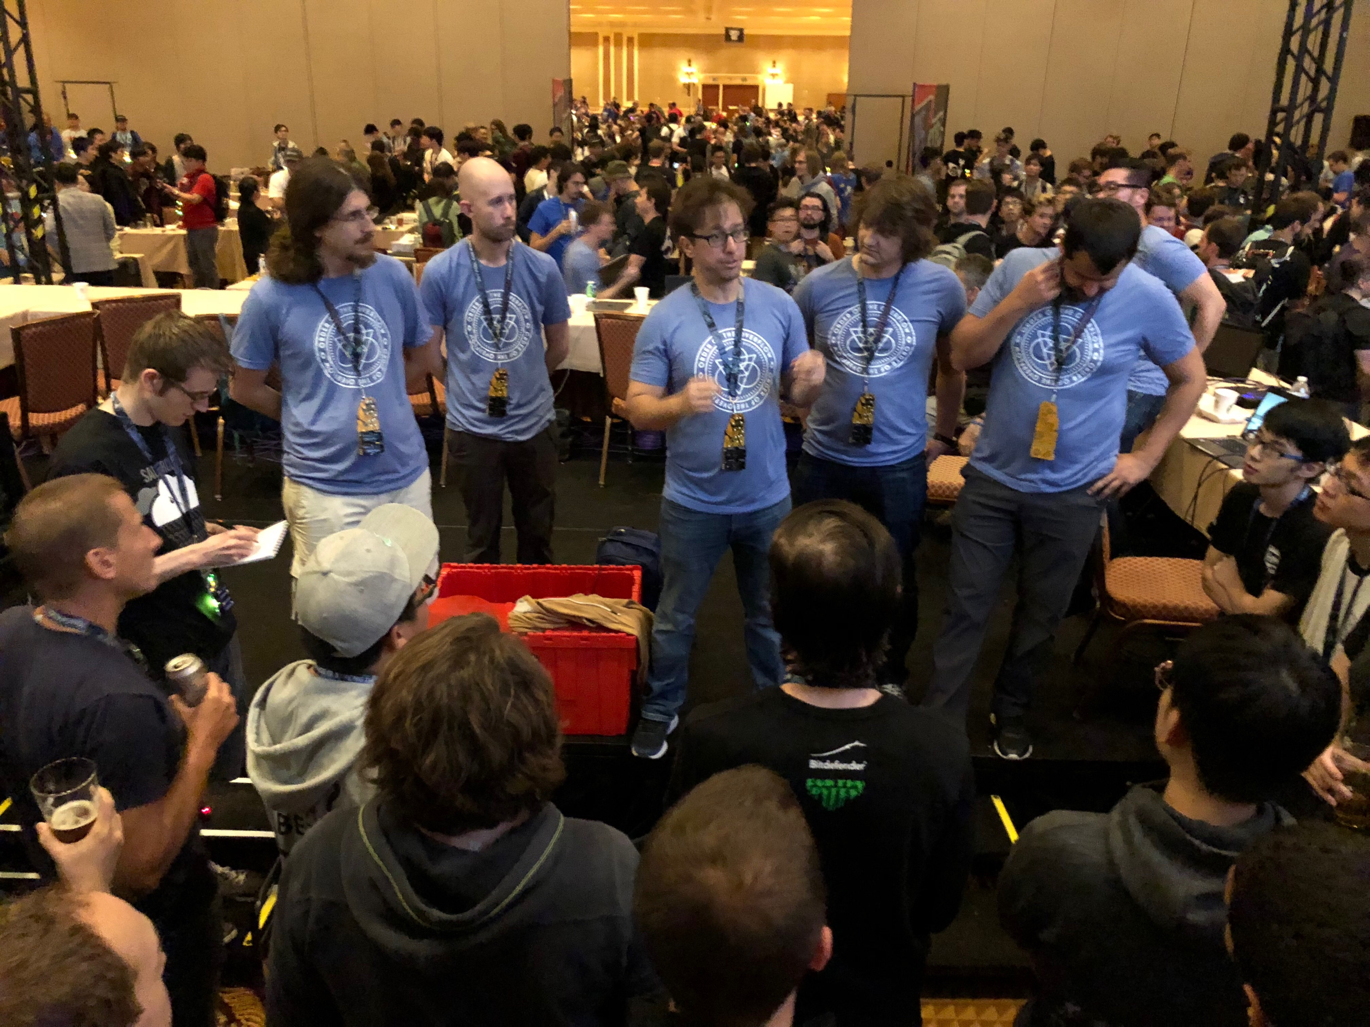

Slide 5
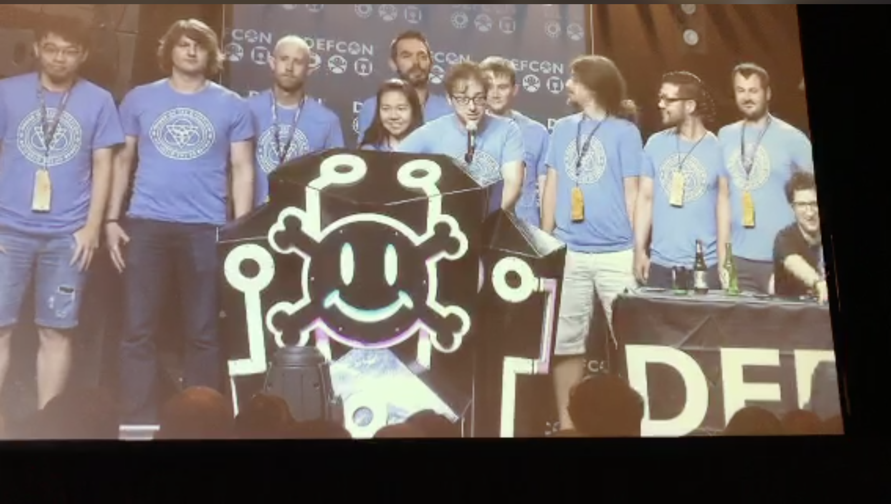

Slide 6
DEFKOR00T Wins!

Slide 7
Security @ ASU
Two undergrad Cyber Security concentration programs
  BS in computer science
  BSE in computer systems engineering
Three graduate Cyber Security concentration programs
  MS
  MCS
  PhD
http://ia.asu.edu/education.php

Slide 8
Security @ ASU
Concentration in BS
  Minimum of 15 credits in Cyber Security and related areas as technical electives
  Core courses
    CSE 365 Introduction to Information Assurance
    CSE 466 Computer System Security
    CSE 467 Data and Information Security
    CSE 468 Network Security
    CSE 469 Computer and Network Forensics

Slide 9
Security @ ASU
NSA and DHS designated ASU and the Cyber Security program a National Center of Academic Excellence in Information Assurance Education

Slide 10
Syllabus
https://adamdoupe.com/teaching/classes/cse365-information-assurance-f18/syllabus.html

