Slide 1
Introduction to Information Assurance
CSE 365 – Information Assurance
Fall 2019
Adam Doupé
Arizona State University
http://adamdoupe.com

Slide 2
Introduction
Professor Adam Doupé
PhD at UCSB
Played CTF with Shellphish, then started the pwndevils @ ASU
Next meeting Friday 8/23, 4pm BYENG 209
http://pwndevils.com/
https://pwndevils.slack.com/
TA Maxfield Lehman
TA Gokul Krishna P

Slide 3
https://www.oooverflow.io/
https://github.com/o-o-overflow
https://twitter.com/oooverflow

Slide 4
Road to DEF CON 27 CTF
6 qualifying CTFs from around the world
1,200 teams competed in our qualification event in May

Slide 5
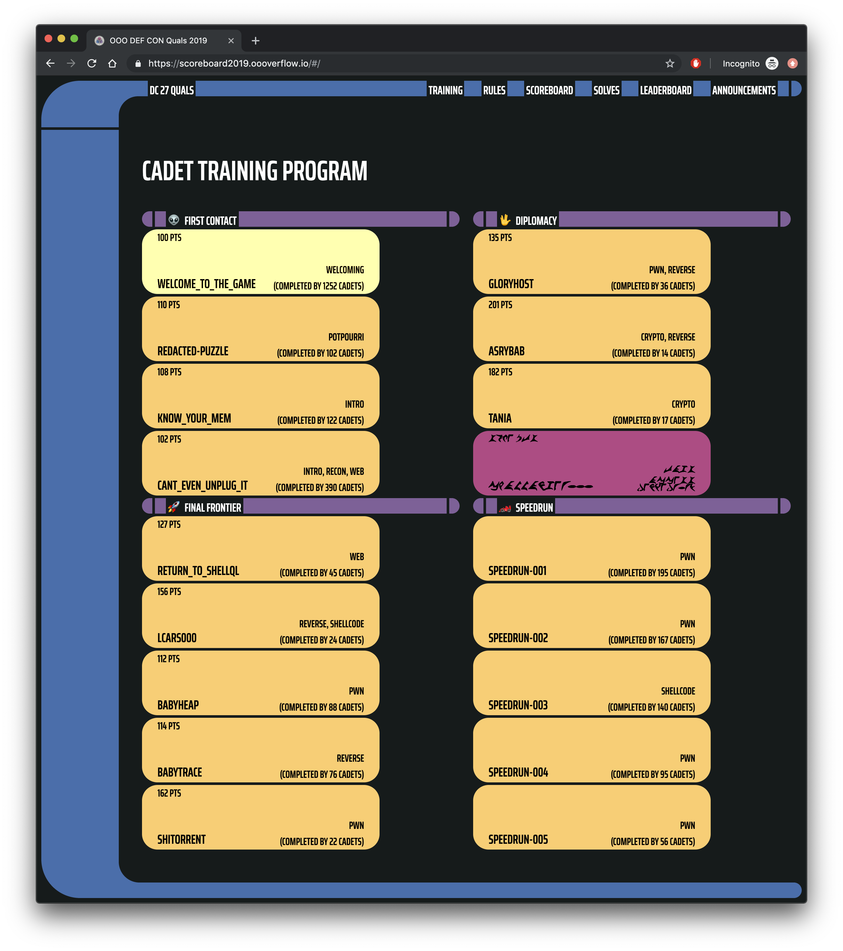
https://scoreboard2019.oooverflow.io/

Slide 6
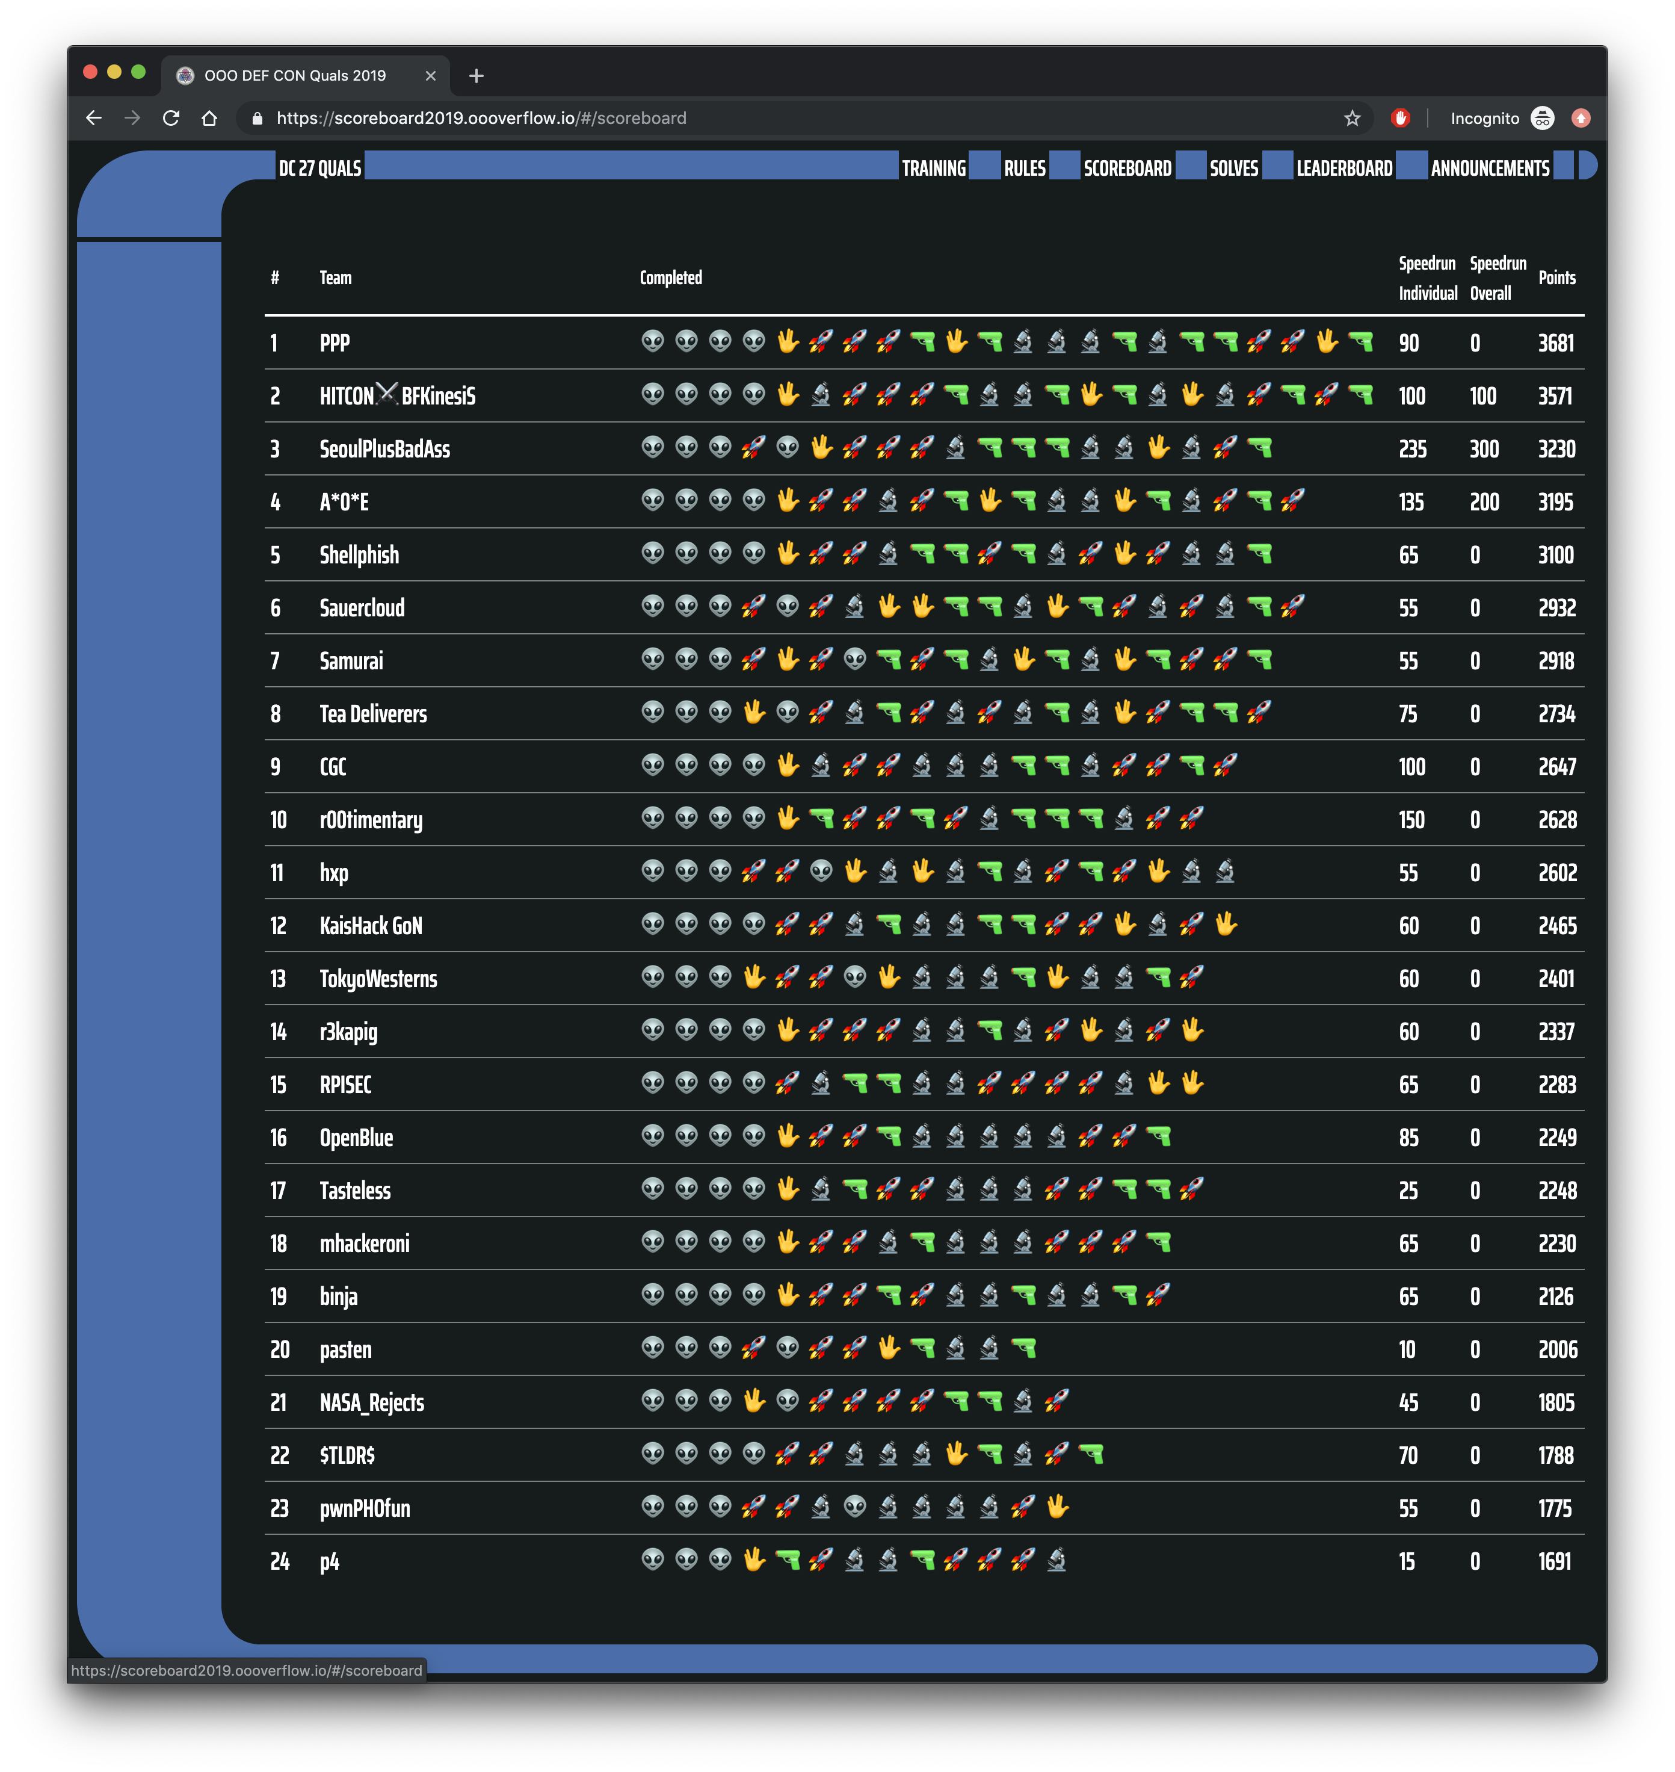

Slide 7
Road to DEF CON 27 CTF
6 qualifying CTFs from around the world
1,200 teams competed in our qualification event in May
Best 16 teams in the world invited to finals, co-located with the DEF CON security conference

Slide 8
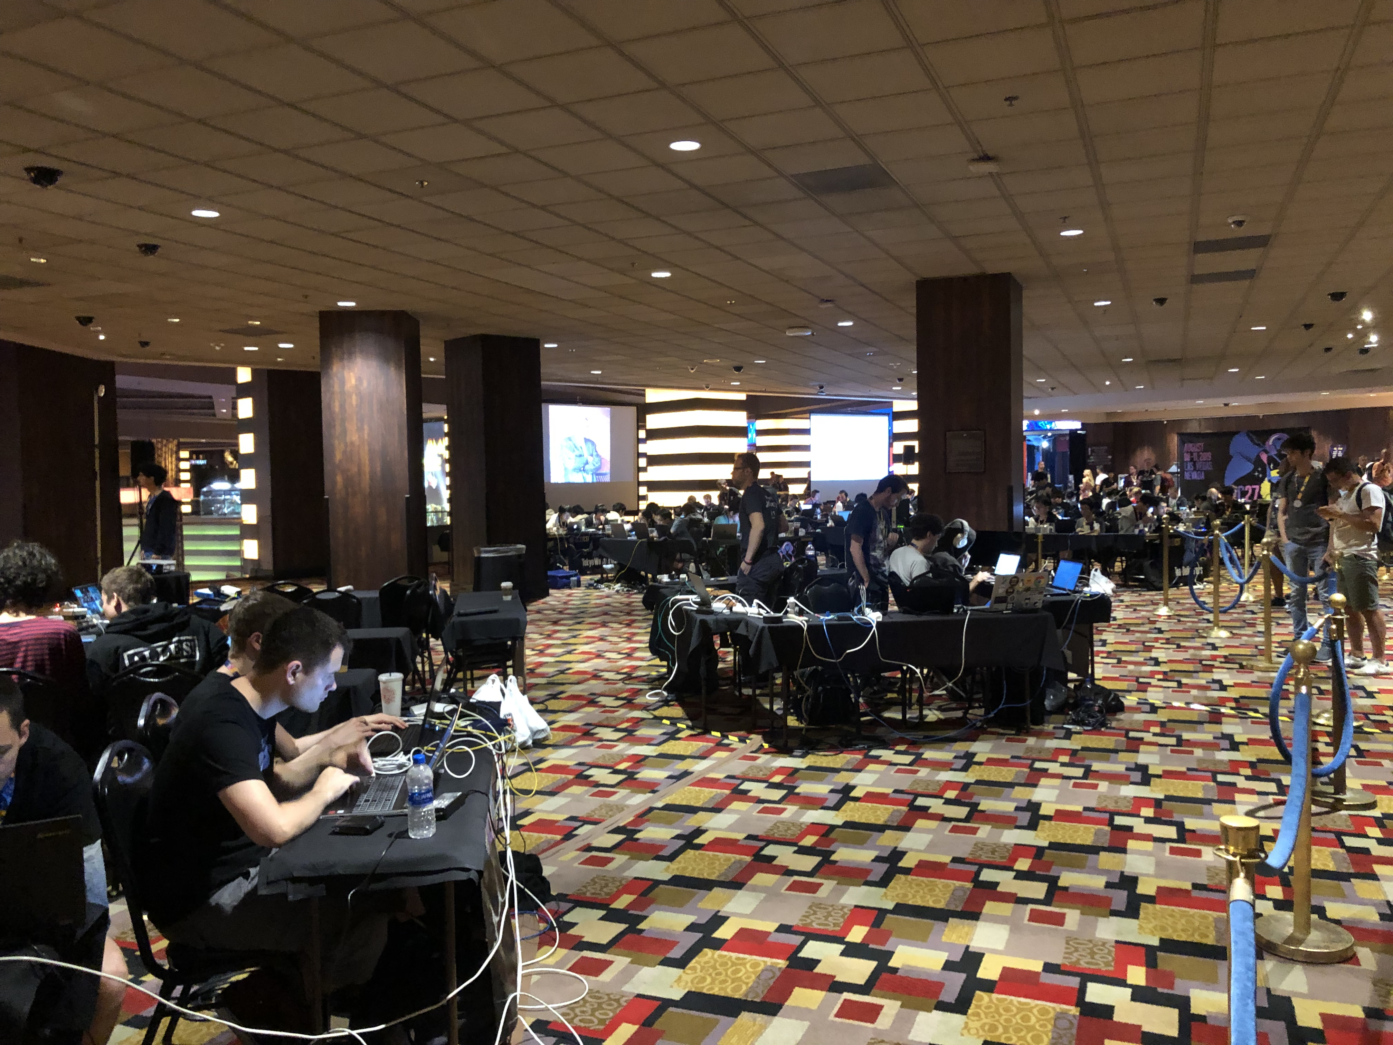

Slide 10
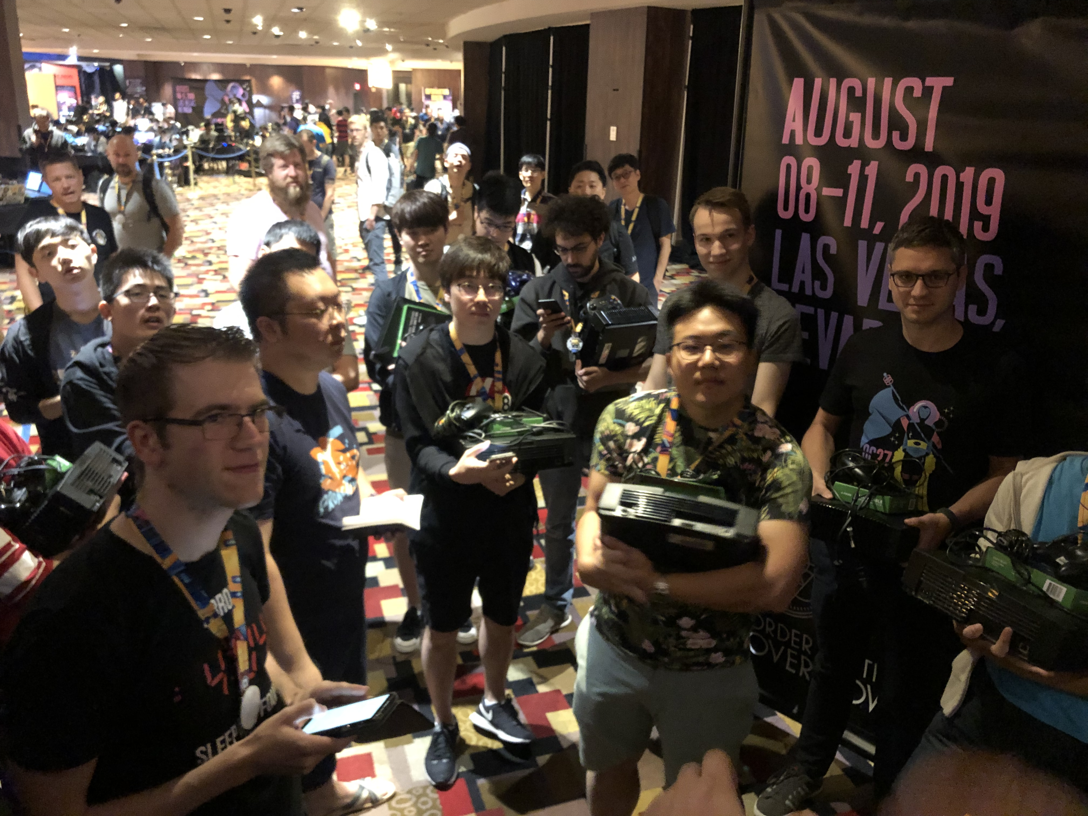

Slide 11
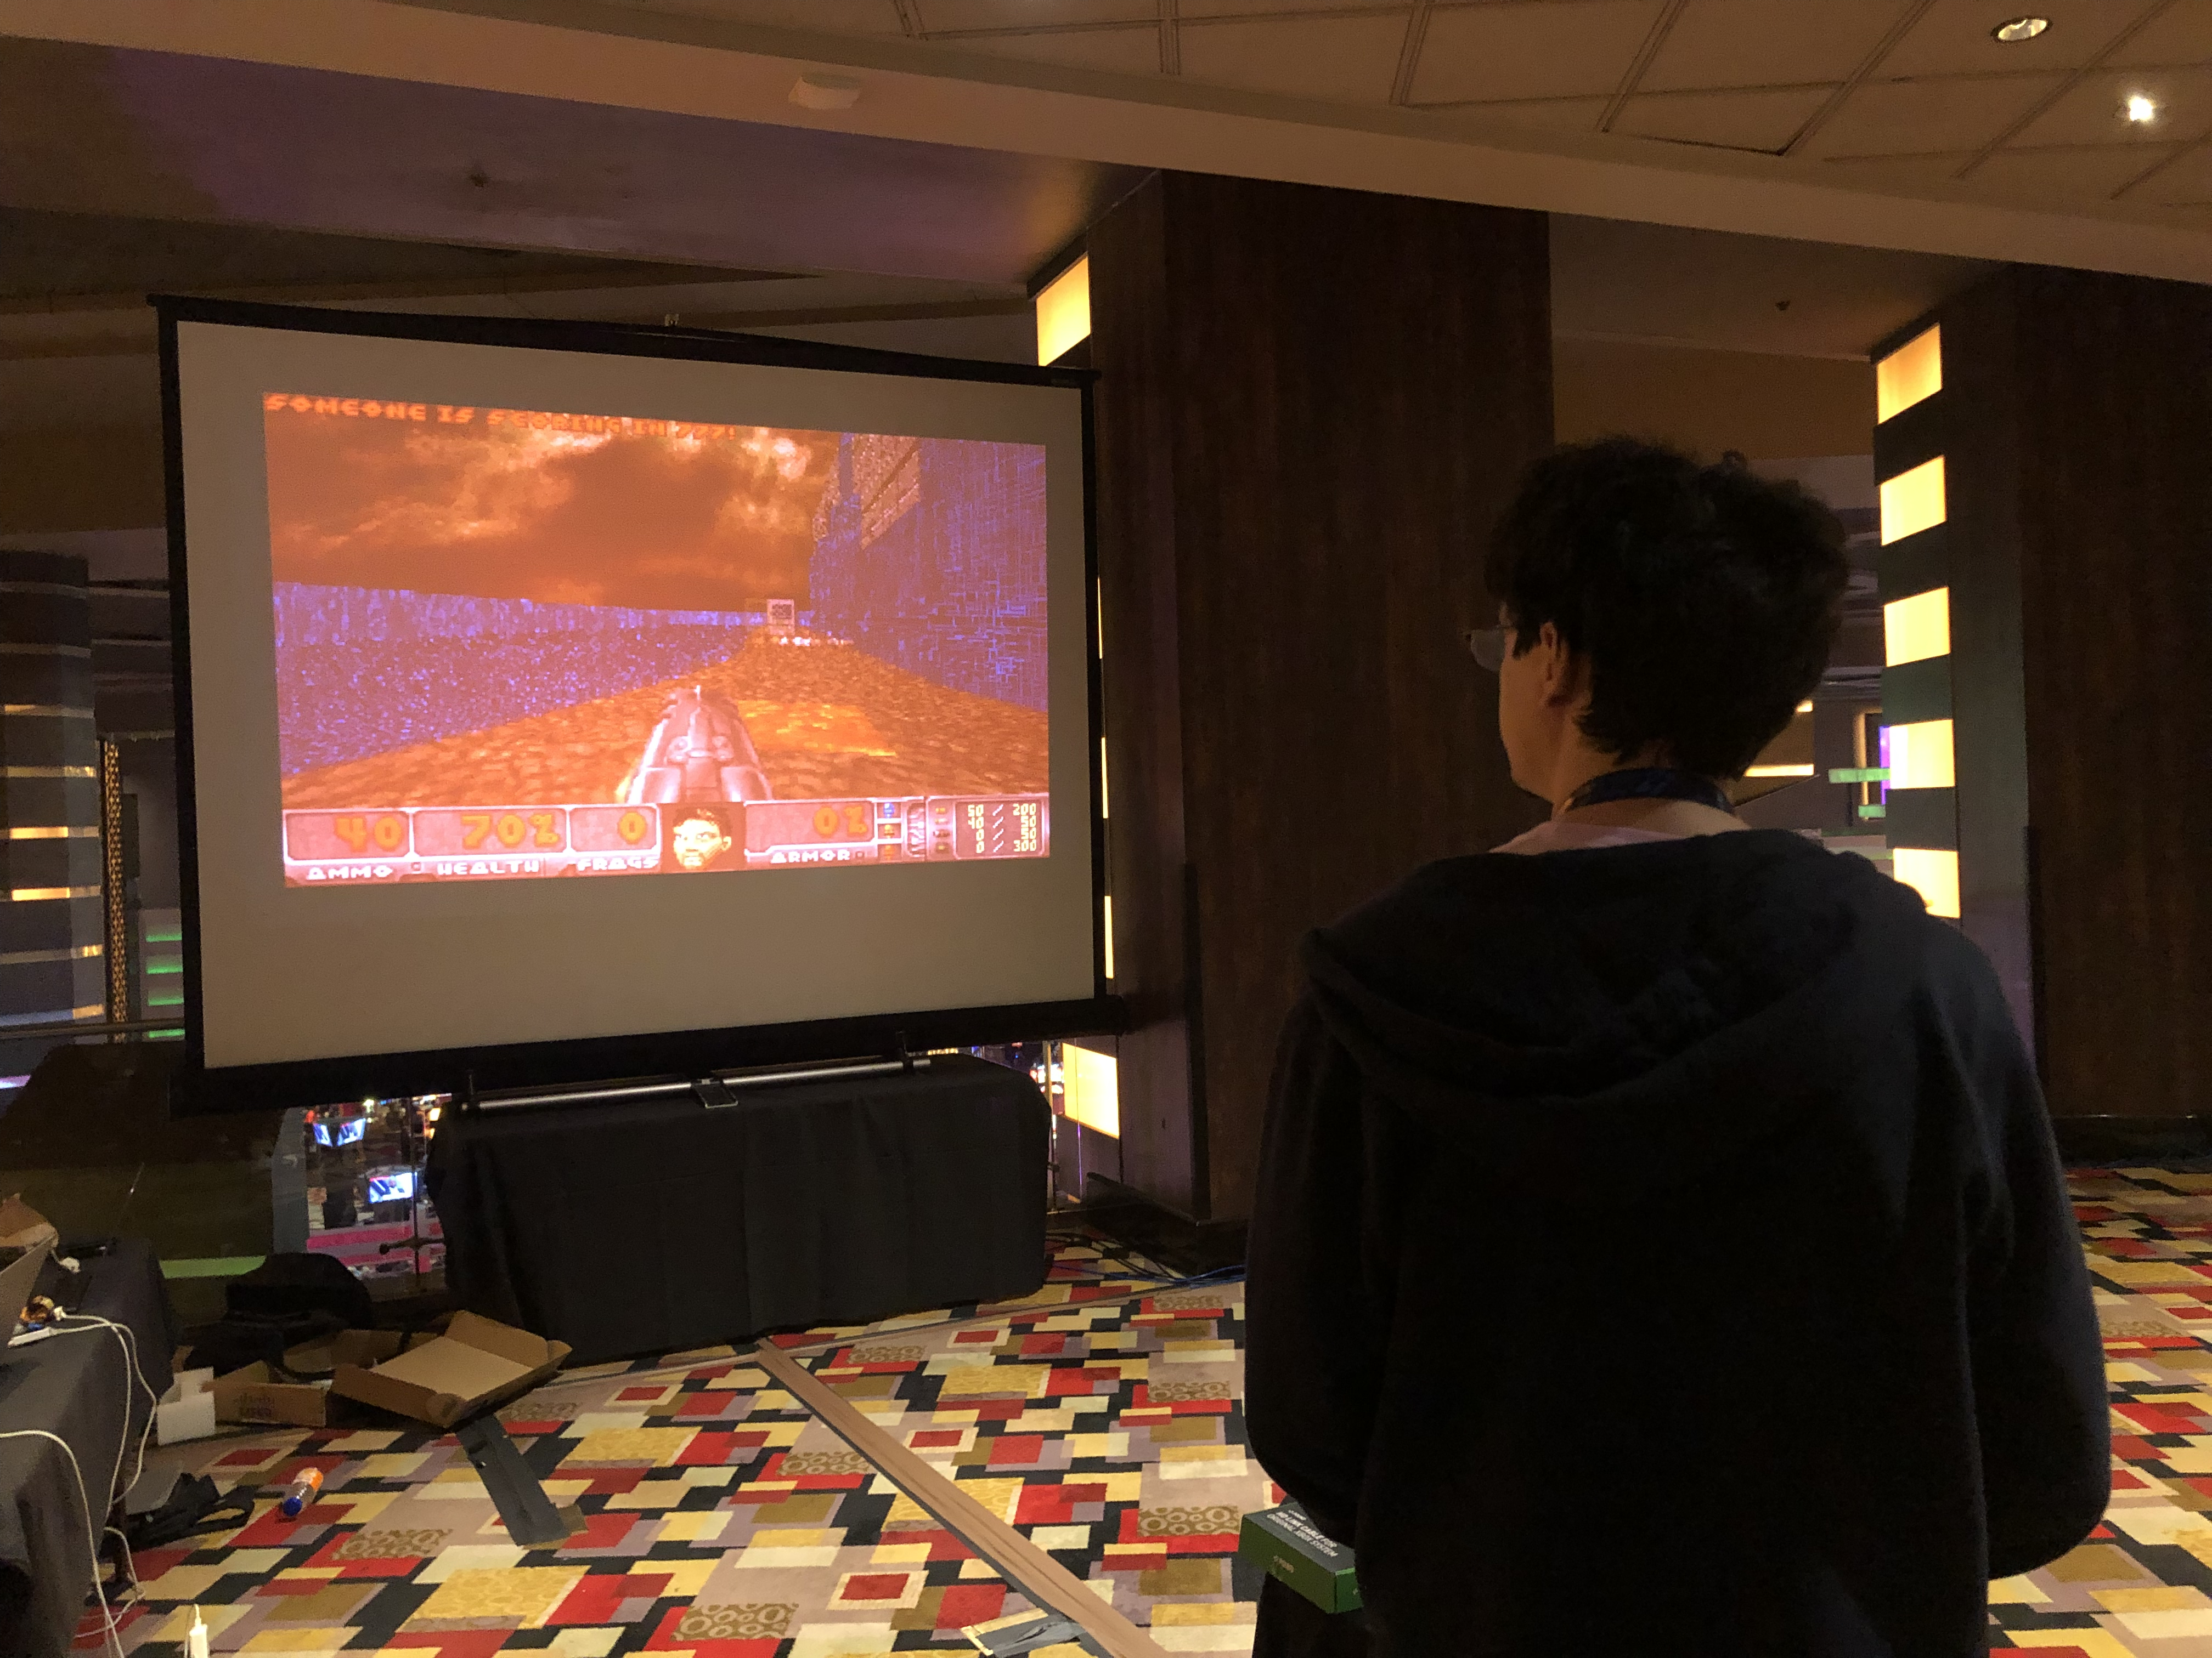

Slide 12
So what did the teams do?
Hacked iOS apps
Via a chat app, similar to telegram
Hacked deep learning models
Neural Networks trained on learning a flag
Hacked Lisp Machine
Lisp Machine (from the early ‘80s) emulator running a web server
Hacked custom Doom running on Xbox
Wrote bit-flip resistant shellcode
…

Slide 14
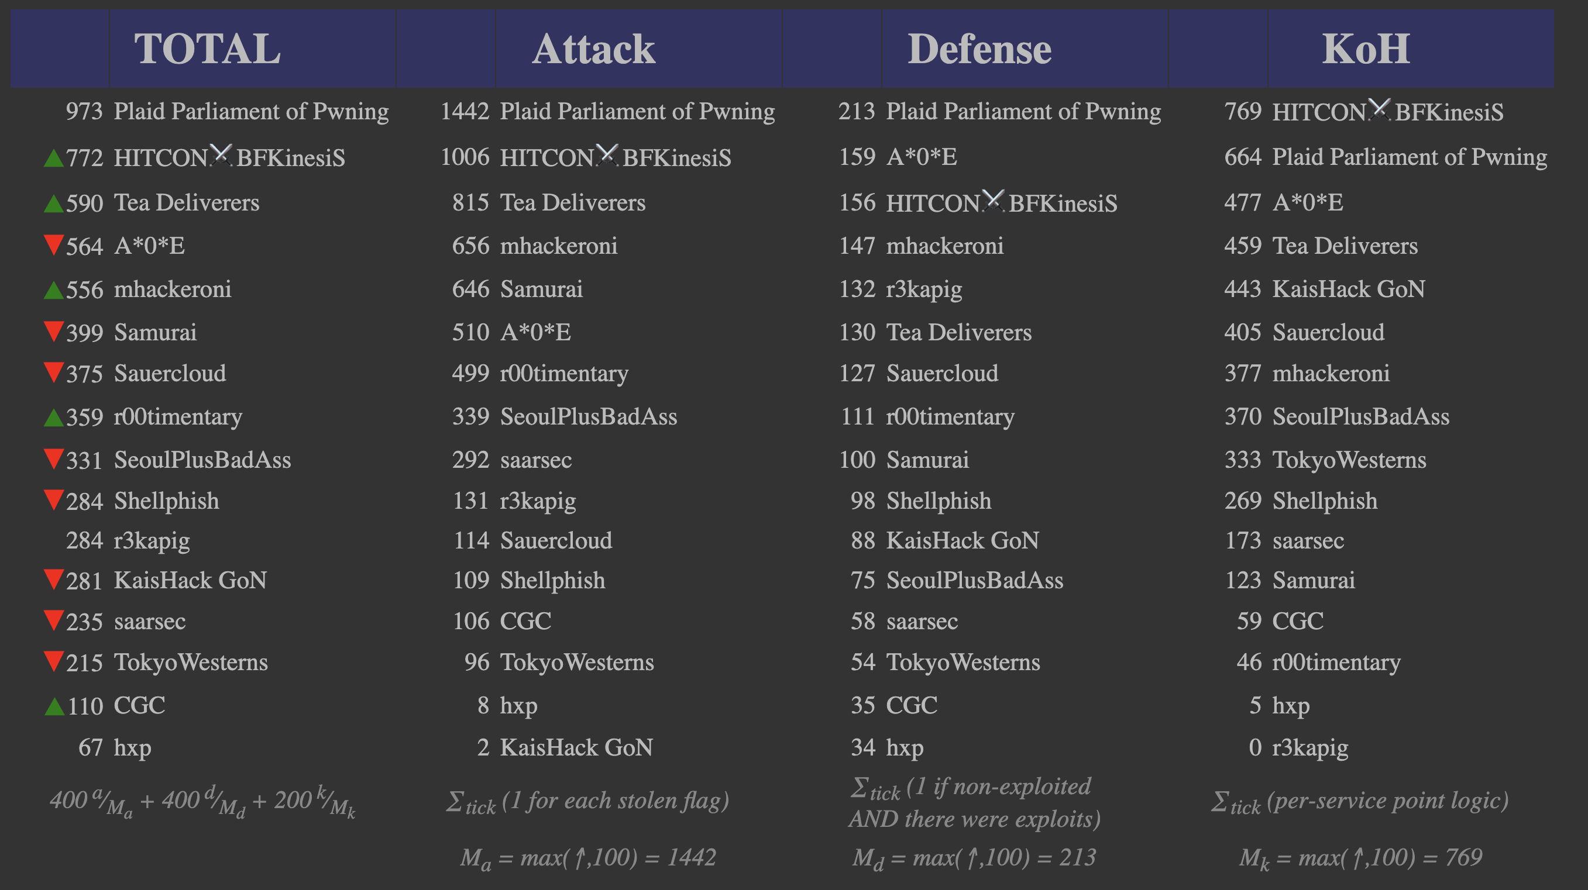

Slide 15
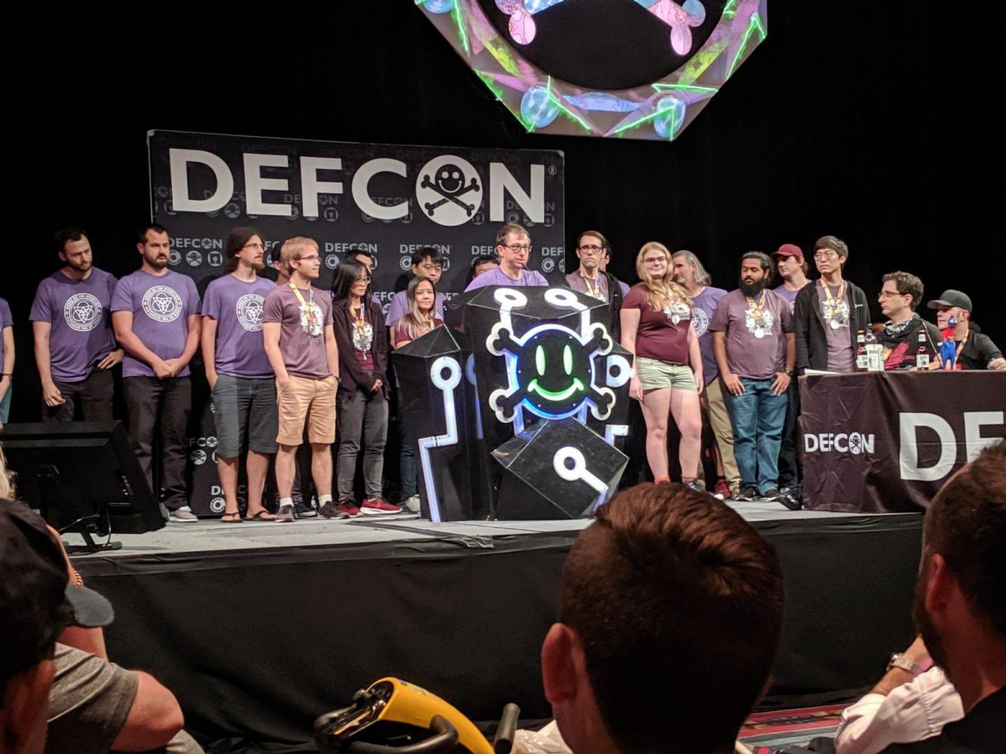

Slide 16
Security @ ASU
Two undergrad Cyber Security concentration programs
BS in computer science
BSE in computer systems engineering
Three graduate Cyber Security concentration programs
MS
MCS
PhD
http://ia.asu.edu/education.php

Slide 17
Security @ ASU
Concentration in BS
Minimum of 15 credits in Cyber Security and related areas as technical electives
Core courses
CSE 365 Introduction to Information Assurance
CSE 466 Computer System Security
CSE 467 Data and Information Security
CSE 468 Network Security
CSE 469 Computer and Network Forensics

Slide 18
Security @ ASU
NSA and DHS designated ASU and the Cyber Security program a National Center of Academic Excellence in Information Assurance Education

Slide 19
Syllabus
https://adamdoupe.com/teaching/classes/cse365-information-assurance-f19/syllabus.html

