Slide 1
Client-Side Scripting
CSE 591 – Security and Vulnerability Analysis
Spring 2015
Adam Doupé
Arizona State University
http://adamdoupe.com
Content of some slides provided by Giovanni Vigna of UCSB, with approval

Slide 2
Overview
So far, we've looked at the technologies of the web
  URIs
  HTTP
  HTML
Then, we looked at how to dynamically generate HTML pages
  Server-side code languages
  SQL databases
Notes:
Consider, how distributed is the web? How does it compare to DNS?

Slide 3
HTML
Original HTML had
  images
  tables
  font sizes
  …
Content was static

Slide 4
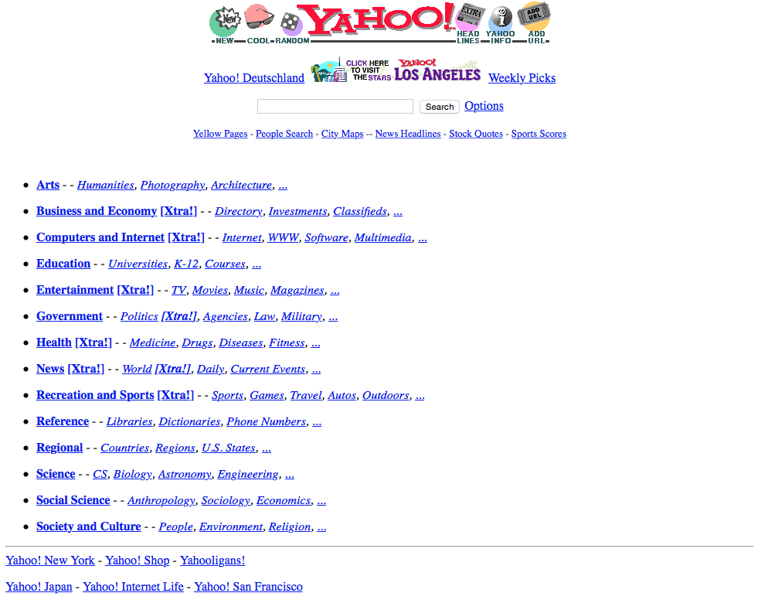
https://web.archive.org/web/19961017235908/http://www2.yahoo.com/
Notes:
October 17th, 1996

Slide 5
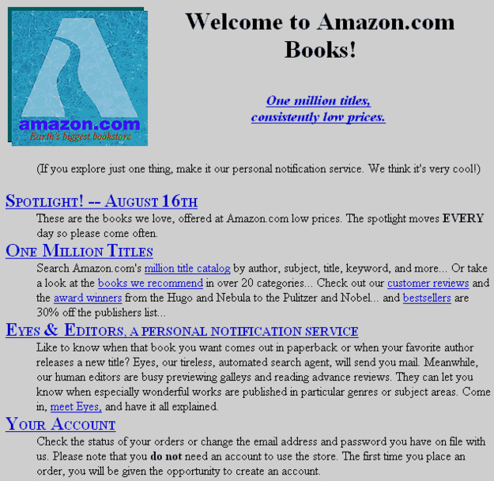
Notes:
Amazon.com at launch, 1995

Slide 6
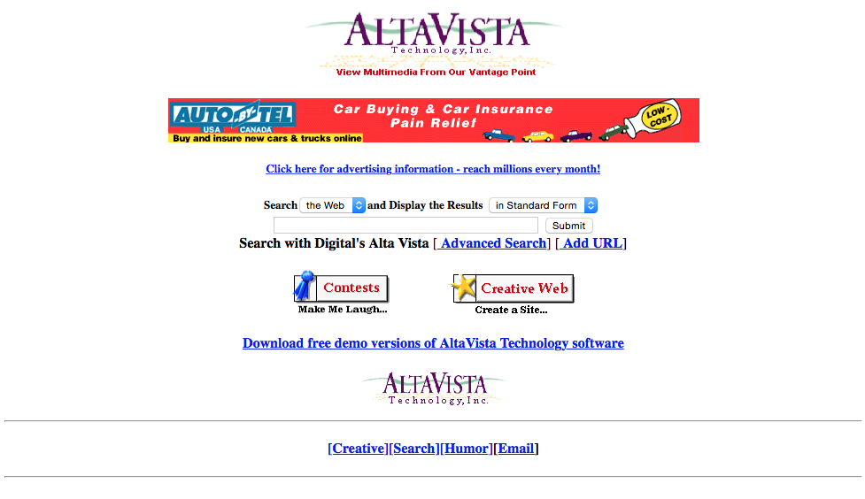
https://web.archive.org/web/19961022174810/http://www.altavista.com/
Notes:
Altavista, 22nd October 1996

Slide 7
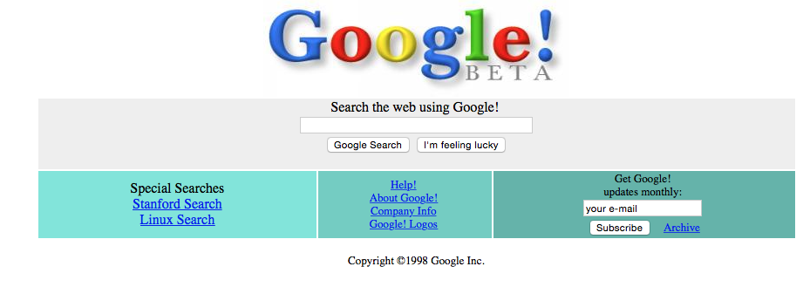
https://web.archive.org/web/19981202230410/http://www.google.com/

Slide 8
HTML Design
HTML designed to describe a text document with hyperlinks to other documents
How to do fancy animations or pretty web pages?

Slide 9
Java Applets
A way of including a Java application as part of a web page
Included by Sun in the first version of Java
  May 23rd 1995, the same day that MySQL was released
Applet is Java bytecode that is downloaded and run on the client's machine
Because Java is cross-platform, you can now distribute a Java program over the Internet using a web page
The applet runs in a sandbox
  Because running arbitrary code from the Internet is a bad idea

Slide 10
Java Applets – Java Code
Subclass java.applet.Applet
Applet is a subclass of java.awt.Panel
  This means that you can use AWT to draw to the applet
Unlike a Java application, a Java applet has no main method
  init
  start
  paint
  stop
  destroy

Slide 11
Java Applets – HTML
applet element was historically used to include an applet
  <applet code='Example' archive='Example.jar' width=300 height=300>Shows in case applet not loaded.</applet>
  applet is deprecated (too specific)
object element allows to include any type of third-party media/plugin
<object type="application/x-java-applet">
<param name="code" value="Example">
<param name="archive" value="Example.jar">
<param name="width" value=300>
<param name="height" value=300>
Shows in case applet not loaded.
</object>
Browser can instantiate JVM and pass parameters

Slide 12
HelloWorld.java
import java.applet.Applet;
import java.awt.*;
public class HelloWorld extends Applet {
// Print a message on the screen (x=20, y=10).
public void paint(Graphics g) {
g.drawString("Hello CSE 591!", 20, 10);
}
}

Slide 13
hellojava.html
<!DOCTYPE html>
<html>
<head>
<meta charset="UTF-8">
<title>Java Applet Example</title>
</head>
<body>
<object type="application/x-java-applet">
<param name="code" value="HelloWorld.class">
<param name="width" value=300>
<param name="height" value=300>
Shows in case applet not loaded.
</object>
</body>
</html>

Slide 14
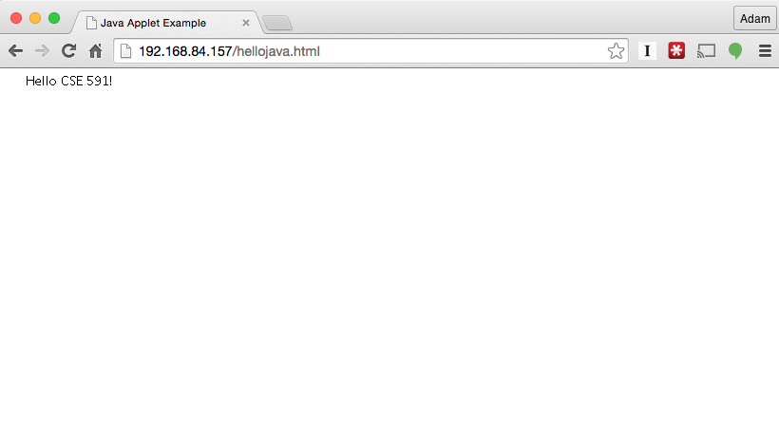
Java Applets – Example

Slide 15
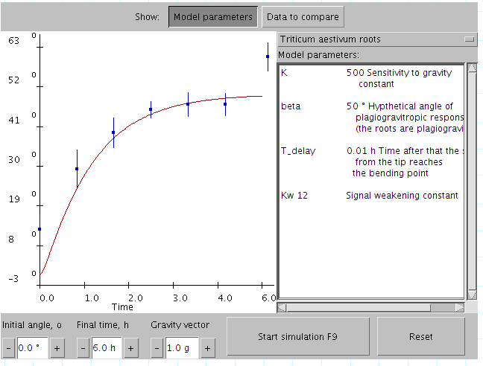
Java Applets – Example

Slide 16
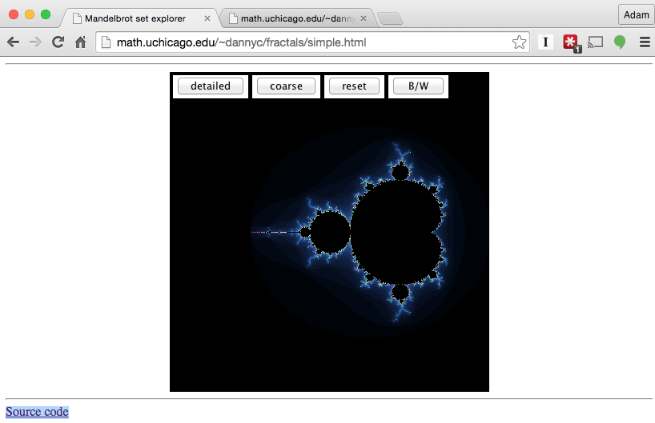
Java Applets – Example

Slide 17
Java Applets
First approach at adding client-side processing to web pages
Applets are typically ugly
  AWT means that applets do not use native look-and-feel
Applets are a security nightmare
  Flaw in the sandbox or JVM means attacker can execute arbitrary code on your machine
Severe restrictions in place now
  Applet must be signed and the user must trust the applet

Slide 18
ActiveX Controls
Binary, OS-specific, programs that are downloaded and executed in the context of a web page
First proposed by Microsoft in 1996 (possibly as a challenge to Java Applets)
Supported by Windows-based browsers only

Slide 19
ActiveX Controls
ActiveX evolved out of COM (Component Object Model) and OLE (Object Linking and Embedding)
  Allows ActiveX controls to be implemented in any language
Included in HTML using the object tag
<object classid="clsid:7A080CC5-26E2-101B-AEBD-04021C009402" id="Testing" height=100 width=100>
</object>
  classid ID references the GUID of the ActiveX control
  id gives it a name to be referenced in JavaScript

Slide 20
ActiveX Controls
Originally, the browser would download and run the code automatically
Once executed, ActiveX controls have complete access to the client's environment
Eventually, the security problems with automatically downloading and running binary code were realized
Code is signed using the Authenticode mechanism

Slide 21
ActiveX Controls
ActiveX is used to implement many browser plug-ins on Windows
  Adobe PDF
  Adobe Flash
  Silverlight
  Quicktime
  Java applets

Slide 22
Adobe Flash
Fundamentally a vector graphics and animation engine
Originally created "SmartSketch" as a way to create animations for pen computing in 1993
Pen computing and SmartSketch failed
Rewrote and rebranded as "FutureSplash" to work as a Netscape plugin May 1996
December 1996 sold FutureSplash to Macromedia, and became Macromedia Flash 1.0
Adobe acquired Macromedia for $3.4 billion, December 2005

Slide 23
Adobe Flash
Used to create animations, videos, or games
Combines vector graphics, animation, video, and scripting language
Scripting language is ActionScript, which is related to JavaScript
Used in the early web to completely write a web page or web site, rather than use HTML
Adobe claims "1 billion connected desktops across browsers and operating systems"

Slide 24
Silverlight
Microsoft Flash competitor and replacement/upgrade to ActiveX
First released in 2007
Idea was to write application in .NET language and the application would run in your browser on the Silverlight run time
Currently deprecated (and basically dead)

Slide 25
JavaScript
Client-Side scripting language for interacting and manipulating HTML
Created by Brendan Eich at Netscape Navigator 2.0 in September 1995 as "LiveScript"
Renamed to "JavaScript" in December 1995 and is (from the Netscape Press Release)
  "announced JavaScript, an open, cross-platform object scripting language for the creation and customization of applications on enterprise networks and the Internet"
JavaScript is a (from wikipedia) "prototype-based scripting language with dynamic typing and first-class functions"
  Does this sound like Java?
Questions over why the name change
  Marketing ploy to capitalize on the "hot" Java language?
  Collaboration between Sun and Netscape?
By August 1996, Microsoft added support for JavaScript to Internet Explorer
  Microsoft later changed the name to JScript to avoid Sun's Java trademark
Submitted to Ecma International for standardization on November 1996
ECMA-262, on June 1997, standardized first version of ECMAScript

Slide 26
JavaScript
Lingua fraca of the web
Eventually supported by all browsers
Language organically evolved along the way

Slide 27
JavaScript
Code can be embedded into HTML pages using the script element and (optionally storing the code in HTML comments)
<script>
<!--
var name = prompt('Please enter your name below.', '');
if (name == null) {
document.write('Welcome to my site!');
}
else {
document.write('Welcome to my site ' + name + '!');
}
-->
</script>
<script type="text/javascript">
<script language="javascript">

Slide 28
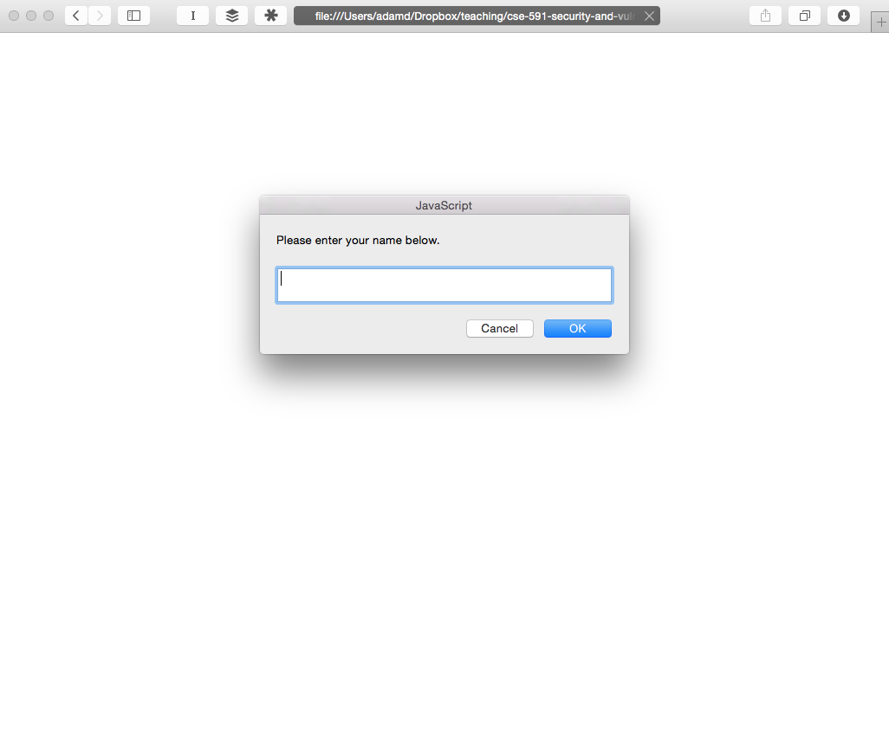

Slide 29
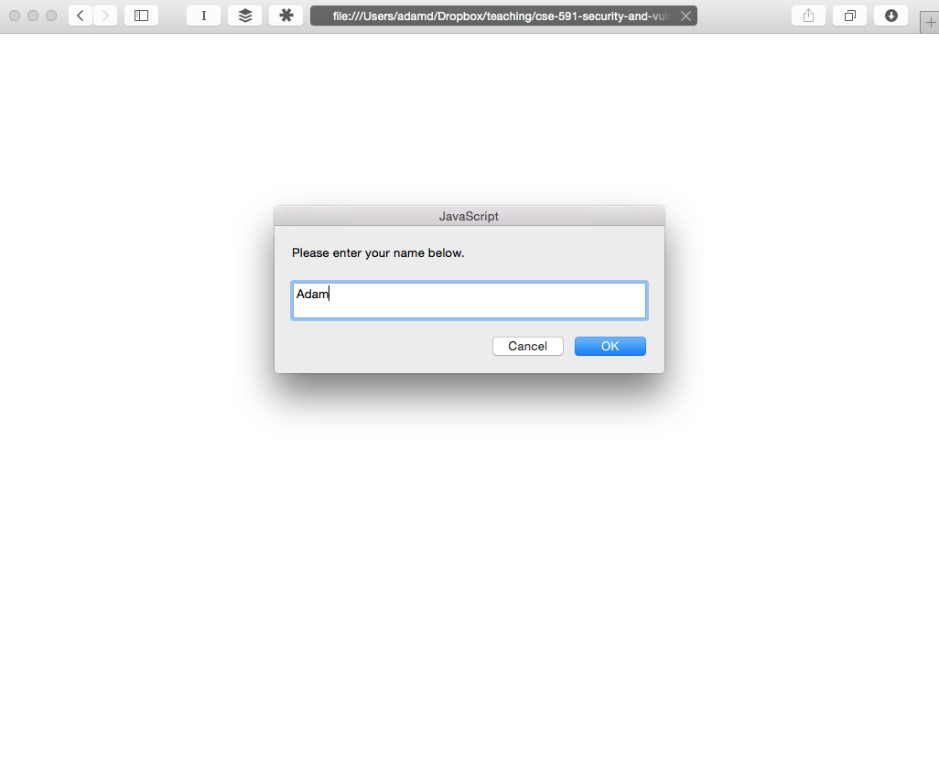

Slide 30
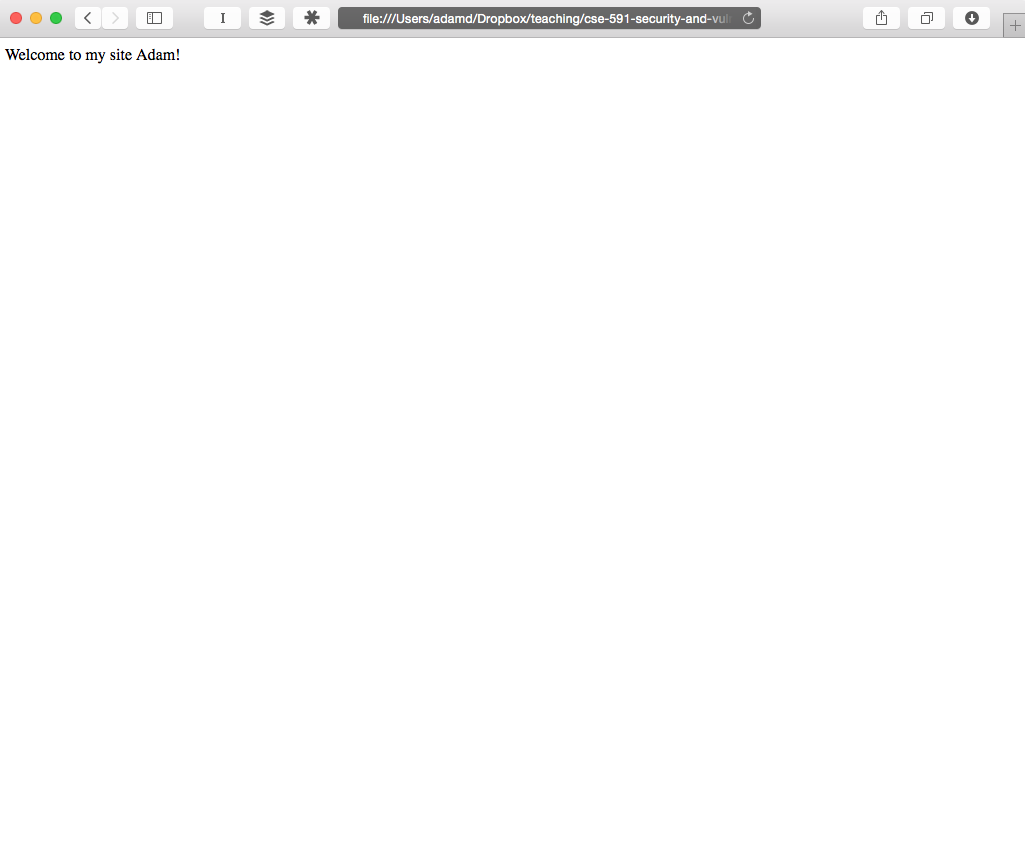

Slide 31
JavaScript
You can also include external JavaScript files in your HTML
  As opposed to the inline JavaScript that we saw in the previous example
<script src="<absolute or relative URL"></script>
When the browser parses this HTML element, it automatically fetches and executes the JavaScript before continuing to parse the rest of the HTML
  Semantically equivalent as if the JavaScript was directly in the page

Slide 32
Document Object Model (DOM)
The Document Object Model is a programmatic interface in JavaScript to the manipulation of client-side content
Created a globally accessible in JavaScript document object
  The document object is used to traverse, query, and manipulate the browser's representation of the HTML page as well as handle events
DOM 0, released in 1995 with original JavaScript
  Very basic
Intermediate DOM began in 1997 with Microsoft and Netscape releasing incompatible improvements to DOM
W3C stepped in and started to define standards
  DOM 1, October 1998
  DOM 2, November 2000
  DOM 3, April 2004
  DOM is now a W3C Living Standard, and various snapshots of the standard will turn into DOM 4

Slide 33
DOM Example
<!DOCTYPE html>
<html>
<head>
<meta charset="UTF-8">
<title>DOM Example</title>
</head>
<body>
<h1>DOM Example</h1>
<div id='insert_here'>
</div>
</body>
<script>
var hr = document.createElement('HR');
document.getElementById('insert_here').appendChild(hr);
</script>
</html>

Slide 34
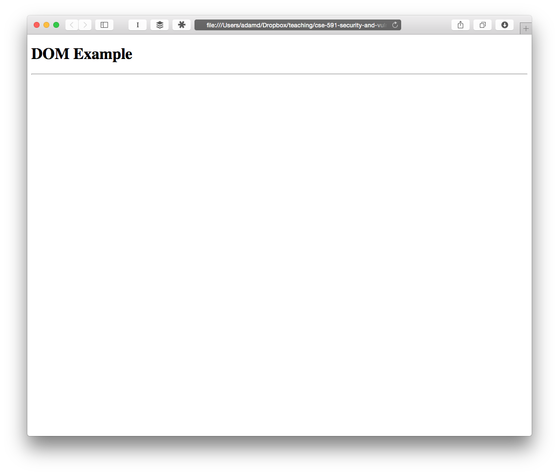

Slide 35
Using the DOM
Coding proper DOM access in a cross-browser approach is a nightmare
  Some highlights from http://stackoverflow.com/questions/565641/what-cross-browser-issues-have-you-faced
    "Internet Explorer does not replace &nbsp; or HTML char code 160, you need to replace its Unicode equivalent \u00a0"
    "In Firefox a dynamically created input field inside a form (created using document.createElement) does not pass its value on form submit."
    "document.getElementById in Internet Explorer will return an element even if the element name matches. Mozilla only returns element if id matches."
jQuery is an amazing library that provides a uniform interface and handles all the DOM cross-browser compatibilities

Slide 36
Browser Object Model (BOM)
Programmatic interface to everything outside the document (aka the browser)
No complete standard (the term BOM is colloquial)
Examples
  window.name = "New name"
  window.close()
  window.location = "http://example.com"

Slide 37
JavaScript vs. DOM and BOM
JavaScript the language is defined separate from the DOM and BOM
  DOM has its own specification, and much of the BOM is specified in HTML5 spec
In the web context, these are often confused, because they are used together so often
However, now with JavaScript popping up all over the place, it's an important distinction
  Server-side code using Node.js
  Database queries (MongoDB)
  Flash (ActionScript, which has its own DOM-like capabilities)
  Java applications (javax.script)
  Windows applications (WinRT)

Slide 38
JavaScript – Object-based
Almost everything in JavaScript is an object
  Objects are associative arrays (hash tables), and the properties and values can be added and deleted at run-time
var object = {test: "foo", num: 50};
object['foo'] = object;
console.log(object[object['test']]);
object.num = 1000;
console.log(object['num']);

Slide 39
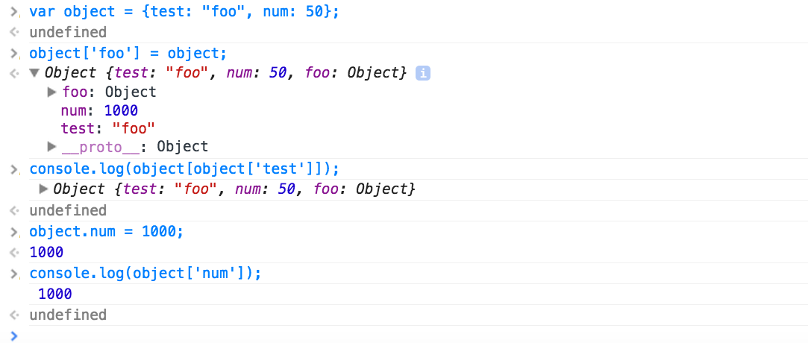

Slide 40
Live Demo

Slide 41
JavaScript – Recursion
function factorial(n) {
if (n === 0) {
return 1;
}
return n * factorial(n - 1);
}
console.log(factorial(5));
120
http://en.wikipedia.org/wiki/JavaScript

Slide 42
JavaScript – Anonymous Functions and Closures
var createFunction = function() {
var count = 0;
return function () {
return ++count;
};
};
var inc = createFunction();
inc();
inc();
inc();
var inc2 = createFunction();
inc2();
http://en.wikipedia.org/wiki/JavaScript

Slide 43
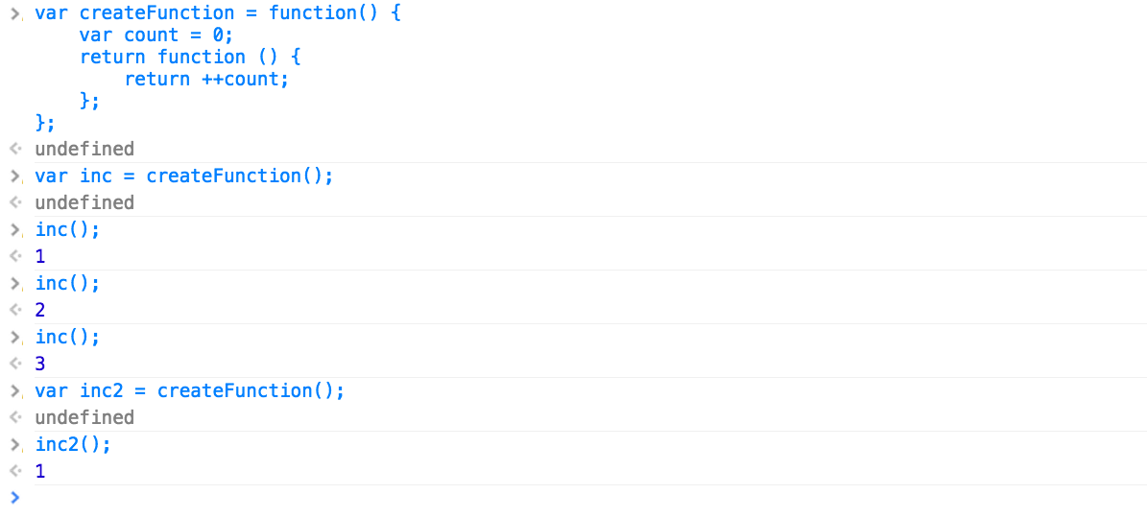

Slide 44
JavaScript – Run-Time Evaluation
JavaScript contains features to interpret a string as code and execute it
  eval
  Function
  setTimeout
  setInterval
  execScript
var foo = "bar";
eval("foo = 'adam';");
console.log(foo);
var x = "console.log('hello');";
var test = new Function(x);
test();

Slide 45
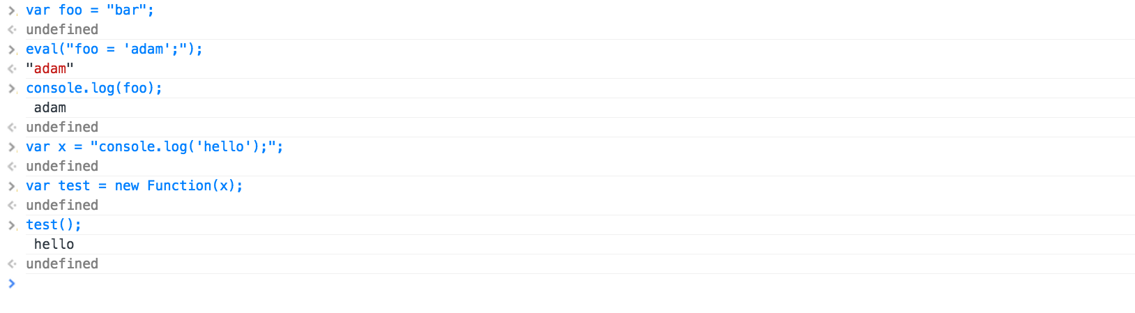

Slide 46
JavaScript Uses – Form Validation
How to validate user input on HTML forms?
Traditionally requires a round-trip to the server, where the server can check the input to make sure that it is valid

Slide 47
JavaScript Uses – Form Validation
<?php
if ($_GET['submit']) {
$student = $_GET['student'];
$class = $_GET['class'];
$grade = $_GET['grade'];
if (empty($student) || empty($class) || empty($grade)) {
echo "<b>Error, did not fill out all the forms</b>";
}
else if (!($grade == 'A' || $grade == 'B' || $grade == 'C' ||
$grade == 'D' || $grade == 'F')) {
echo "<b>Error, grade must be one of A, B, C, D, or F</b>";
}
else {
echo "<b>Grade successfully submitted!</b>";
}
} ?>
<form>
Student: <input type="text" name="student"><br>
Class: <input type="text" name="class"><br>
Grade: <input type="text" name="grade"><br>
<input type="submit" name="submit">
</form>

Slide 48
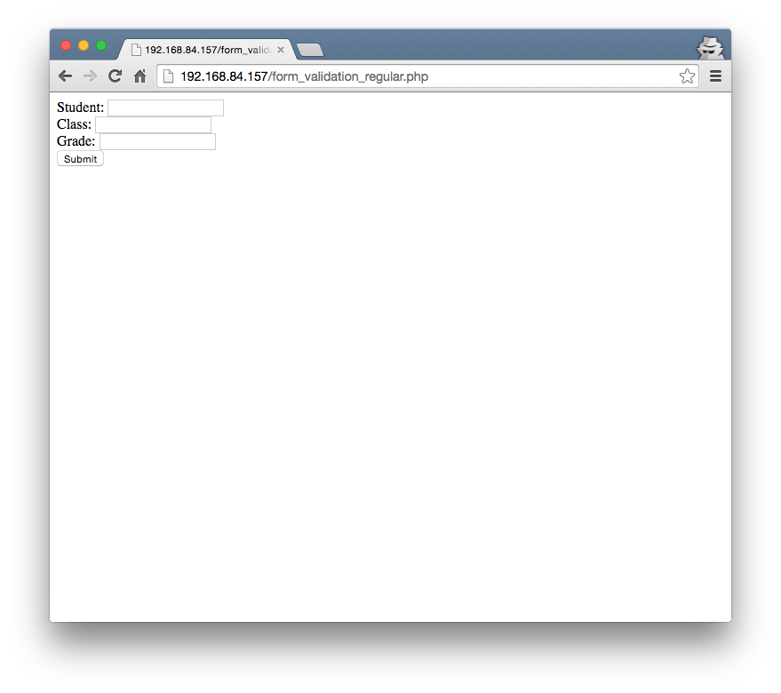

Slide 49
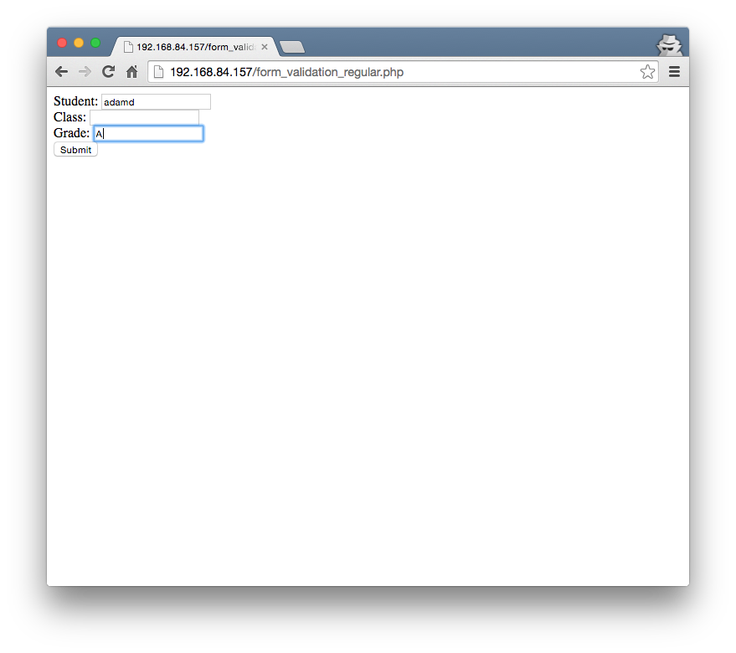

Slide 50
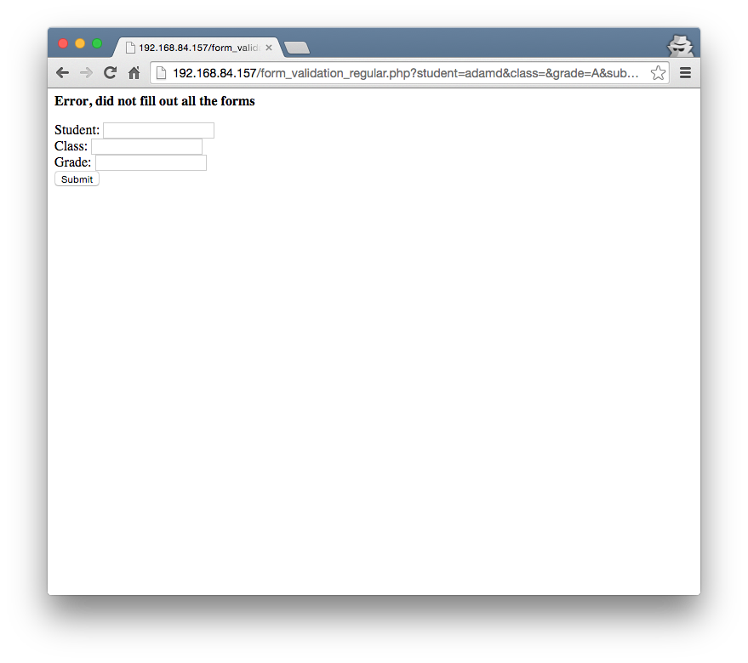

Slide 51
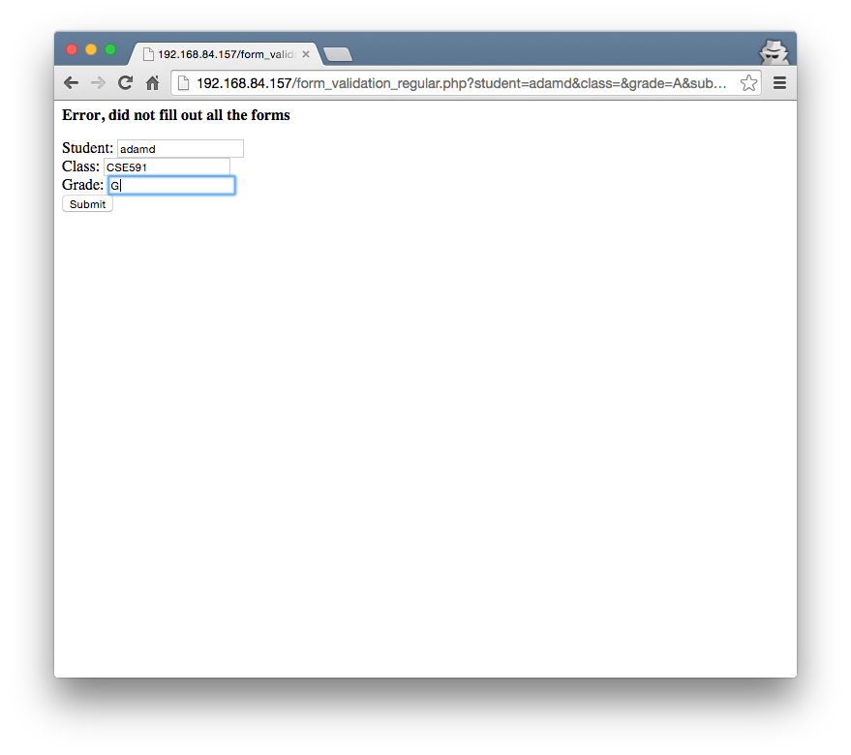

Slide 52
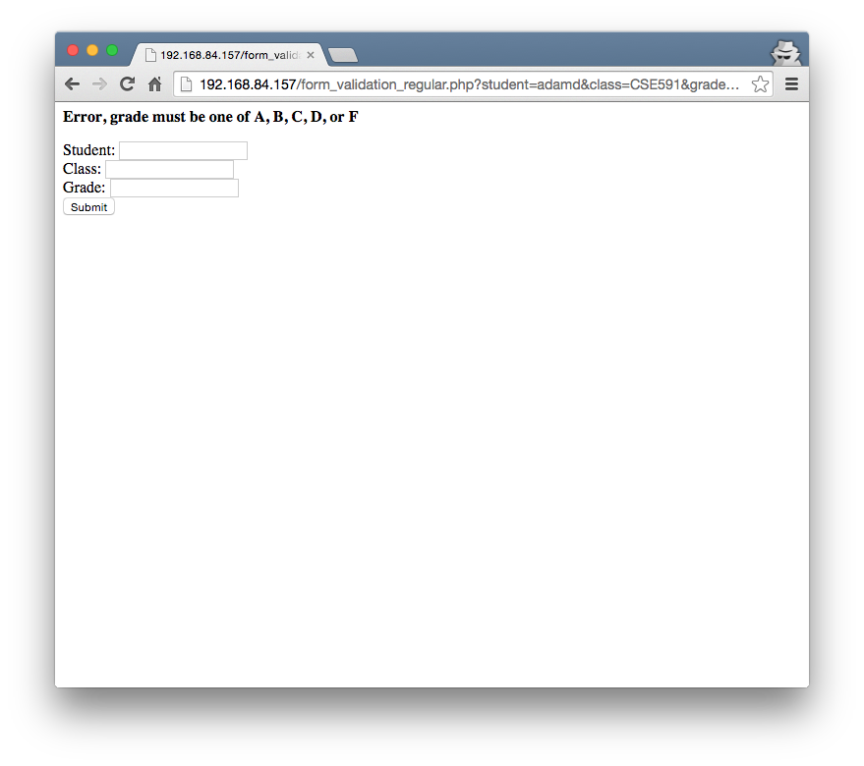

Slide 53
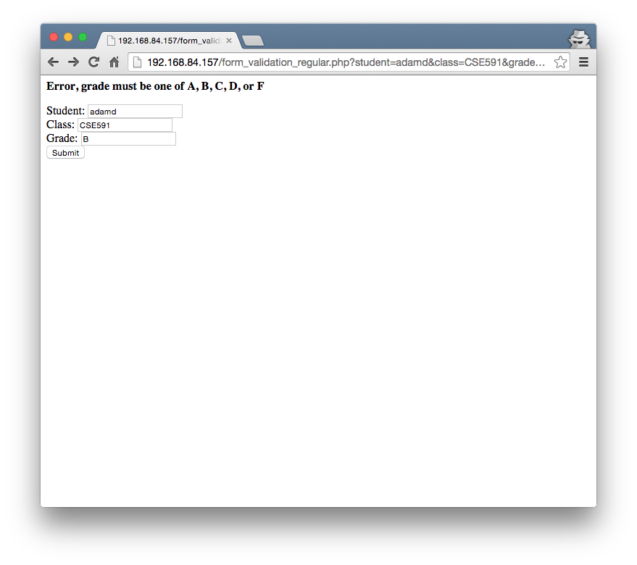

Slide 54
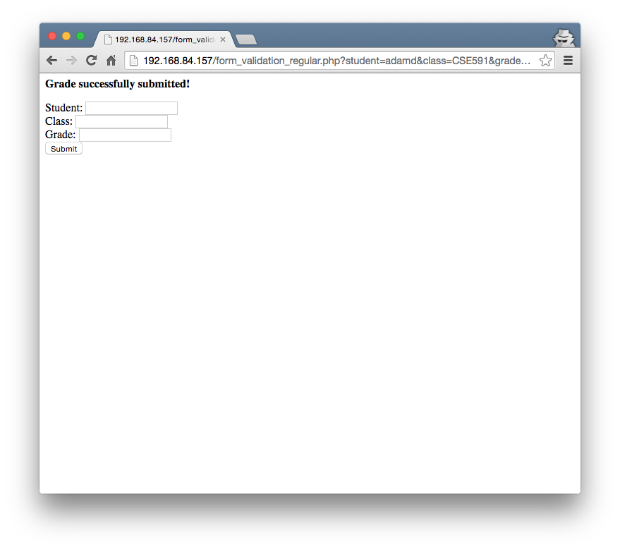

Slide 55



form_validation_regular.php
empty class field
wrong grade format
correct submission
Notes:
Note that these are just HTTP requests and responses. There are also TCP connection establishment (which requires two round trips).

Slide 56
JavaScript Uses – Form Validation
<script>
function check_form() {
var form = document.getElementById("the_form");
if (form.student.value == "" || form.class.value == "" || form["grade"].value == ""){
alert("Error, must fill out all the form");
return false;
}
var grade = form["grade"].value;
if (!(grade == 'A' || grade == 'B' || grade == 'C' ||
grade == 'D' || grade == 'F')) {
alert("Error, grade must be one of A, B, C, D, or F");
return false;
}
return true;
}
</script>
<form id="the_form" onsubmit="return check_form()">
Student: <input type="text" name="student"><br>
Class: <input type="text" name="class"><br>
Grade: <input type="text" name="grade"><br>
<input type="submit" name="submit">
</form>

Slide 57
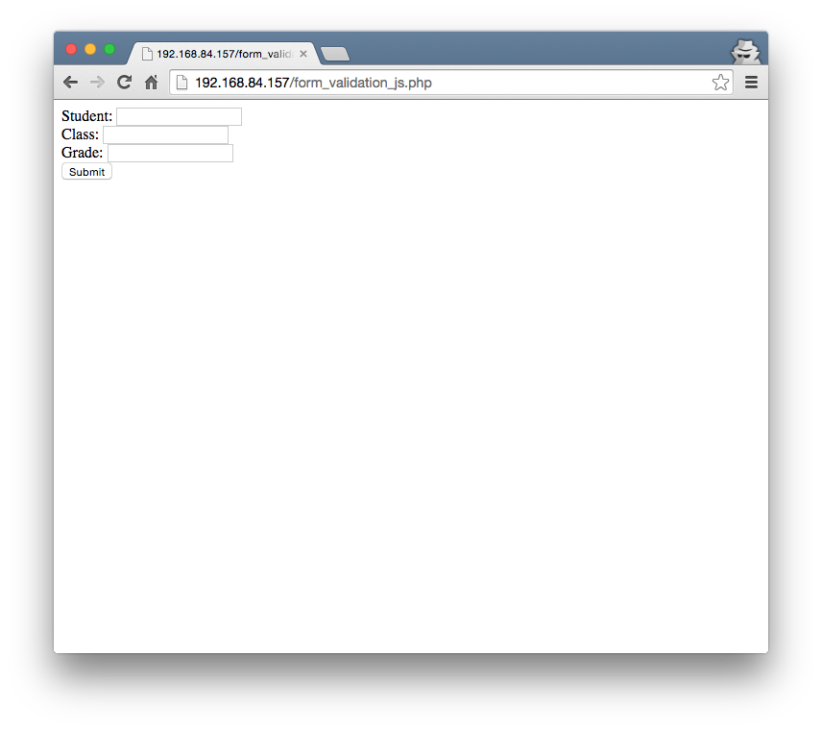

Slide 58
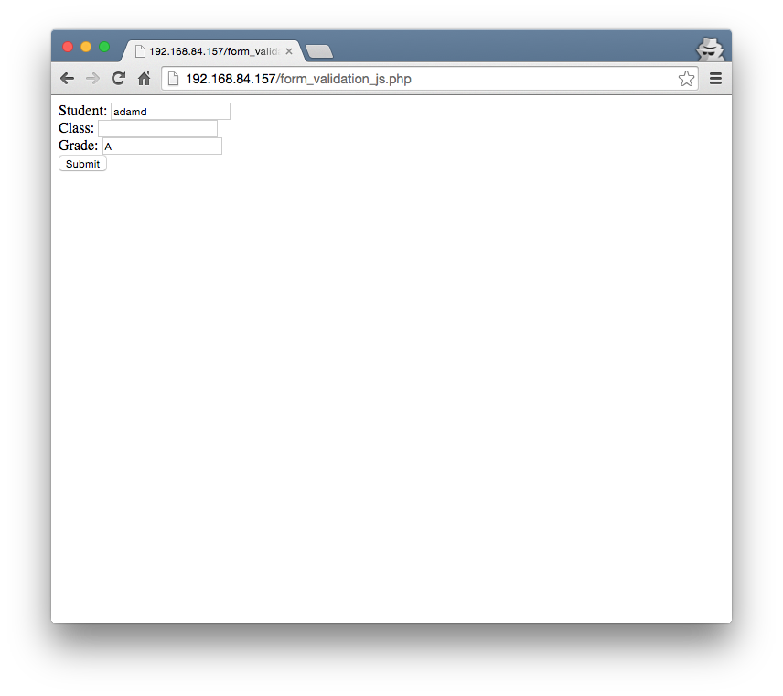

Slide 59
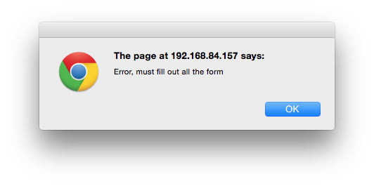

Slide 60

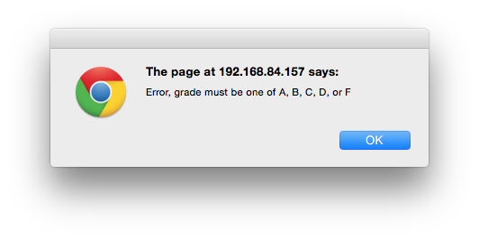

Slide 62
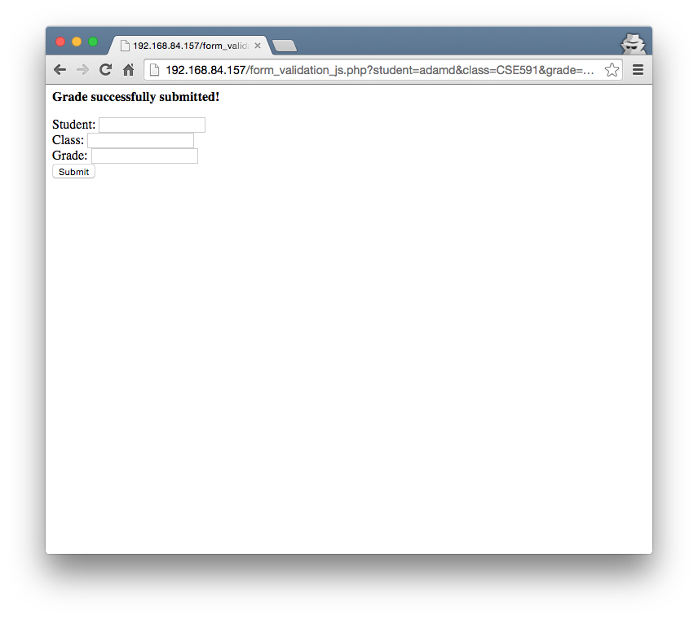

Slide 63
form_validation_js.php
correct submission

Slide 64
Client-Side Validation
Now that we're doing validation on the client, can we get rid of all those PHP checks in our server-side code?
  No!
  No guarantee that client-side validation is performed
    User disables JavaScript
    Command-line clients (Assignment 1 Part 2, curl)
Otherwise, users could enter arbitrary data that does not conform to your validation
  Could lead to a security compromise or not
So the validation must remain on the server-side and the client-side
  Brings up another problem, how to perform consist validation when server-side and client-side written in different languages

Slide 65
DHTML
Using JavaScript with HTML was called Dynamic HTML (DHTML)
  Change images
  Validate forms
  Hide or add content based on user input
However, all the HTML data was sent to the user in one HTTP request
Had to make additional HTTP requests to load additional data, which would also have to send an entire page

Slide 66
The XMLHttpRequest Object
Microsoft developers working on Outlook Web Access for Exchange 2000
  An example is http://ex2010.asu.edu/
Scalability problems with traditional web application
They created a DHTML version (circa) 1998 using an ActiveX control to fetch bits of data from the server using JavaScript
OWA team got the MSXML team (MSXML is Microsoft's XML library, and it shipped with IE) to include their ActiveX control (hence the XML in the name)
  Shipped in IE 5, March 1999
Exchange 2000 finally released in November 2000, and OWA used the ActiveX Object
Added by Netscape in December 2000 as XMLHttpRequest
Find the full story here: http://www.alexhopmann.com/story-of-xmlhttp/

Slide 67
The XMLHttpRequest Object
Allows JavaScript code to (asynchronously) retrieve data from the server, then process the data and update the DOM
Because of the origin (ActiveX control on windows and included in Netscape's DOM), used to need two different ways to instantiate the control
  Most browsers:
    http_request = new XMLHttpRequest();
  Internet Explorer
    http_request = new ActiveXObject("Microsoft.XMLHTTP");

Slide 68
Creating an XMLHttpRequest
Using the onreadystatechange property of an XMLHttpRequest object one can set the action to be performed when the result of a query is received
  http_request.onreadystatechange = function(){
  <code here
  >};
Then, one can execute the request
http_request.open('GET', 'http://example.com/show.php?keyword=foo', true);
http_request.send();
Note that the third parameter indicates that the request is asynchronous, that is, the execution of JavaScript will proceed while the requested document is being downloaded

Slide 69
XMLHttpRequest Lifecycle
The function specified using the "onreadystatechange" property will be called at any change in the request status
  0 (uninitialized: Object is not initialized with data)
  1 (loading: Object is loading its data)
  2 (loaded: Object has finished loading its data)
  3 (interactive: User can interact with the object even though it is not fully loaded)
  4 (complete: Object is completely initialized)
Usually wait until the status is “complete”
  if (http_request.readyState == 4) {
  operates on data} else {
  not ready, return}

Slide 70
XMLHttpRequest Success
After having received the document (and having checked for a successful return code – 200) the content of the request can be accessed:
  As a string by calling: http_request.responseText
  As an XMLDocument object: http_request.responseXML
    In this case the object can be modified using the JavaScript DOM interface

Slide 71
XMLHttpRequest Example
<!DOCTYPE html>
<html>
<head>
<meta charset="UTF-8">
<title>AJAX Example</title>
</head>
<body>
<h1>AJAX Example</h1>
<div id='insert_here'>
</div>
<script>
…
</script>
</body>
</html>

Slide 72
XMLHttpRequest Example
if (typeof XMLHttpRequest != "undefined") {
var http_request = new XMLHttpRequest();
}
else {
var http_request = new ActiveXObject("Microsoft.XMLHTTP");
}
if (typeof console == "undefined") {
console = { "log" : function (text) { alert(text); } };
}
http_request.onreadystatechange = function () {
console.log(http_request.readyState);
if (http_request.readyState === 4) {
var text = http_request.responseText;
var new_node = document.createTextNode(text);
document.getElementById('insert_here').appendChild(new_node);
}
};
console.log("Before Request");
http_request.open('GET', 'ajax_test.txt', true);
http_request.send();
console.log("After Request");

Slide 73
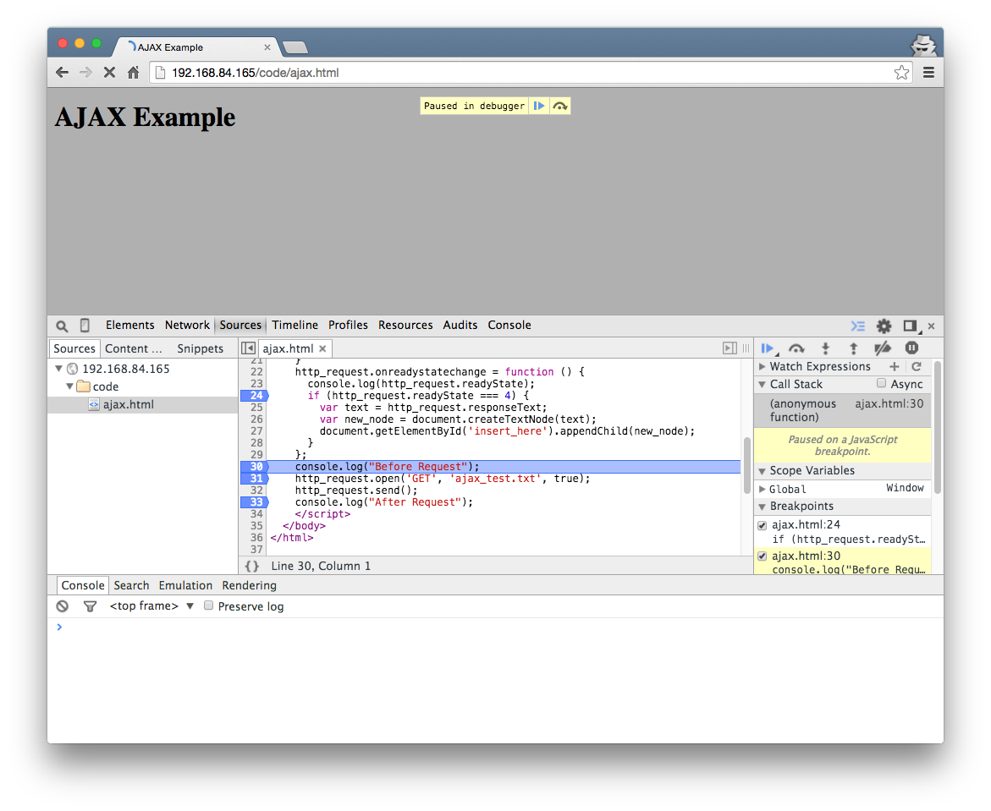

Slide 74
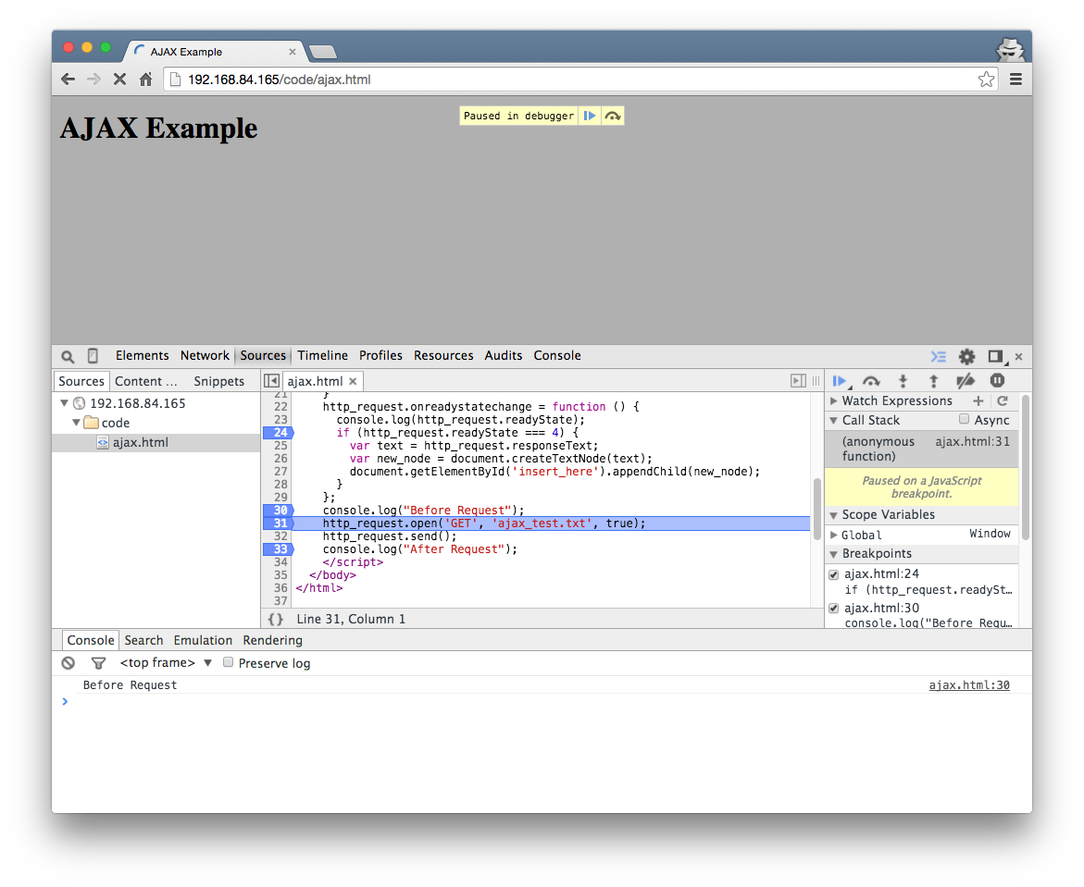

Slide 75
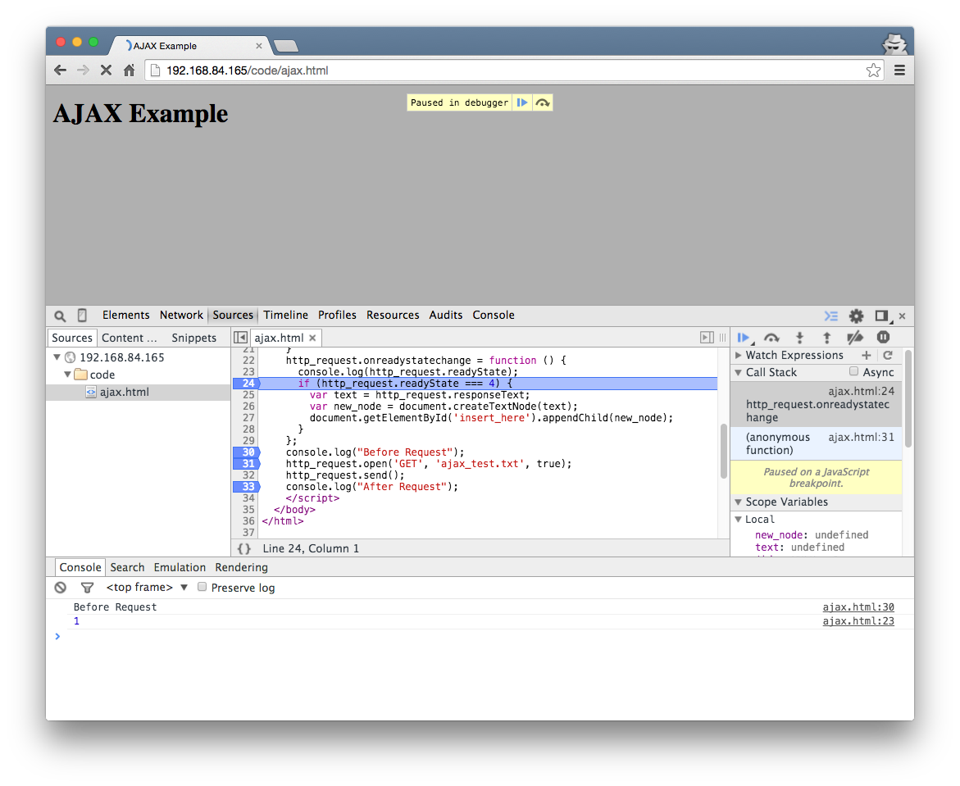

Slide 76
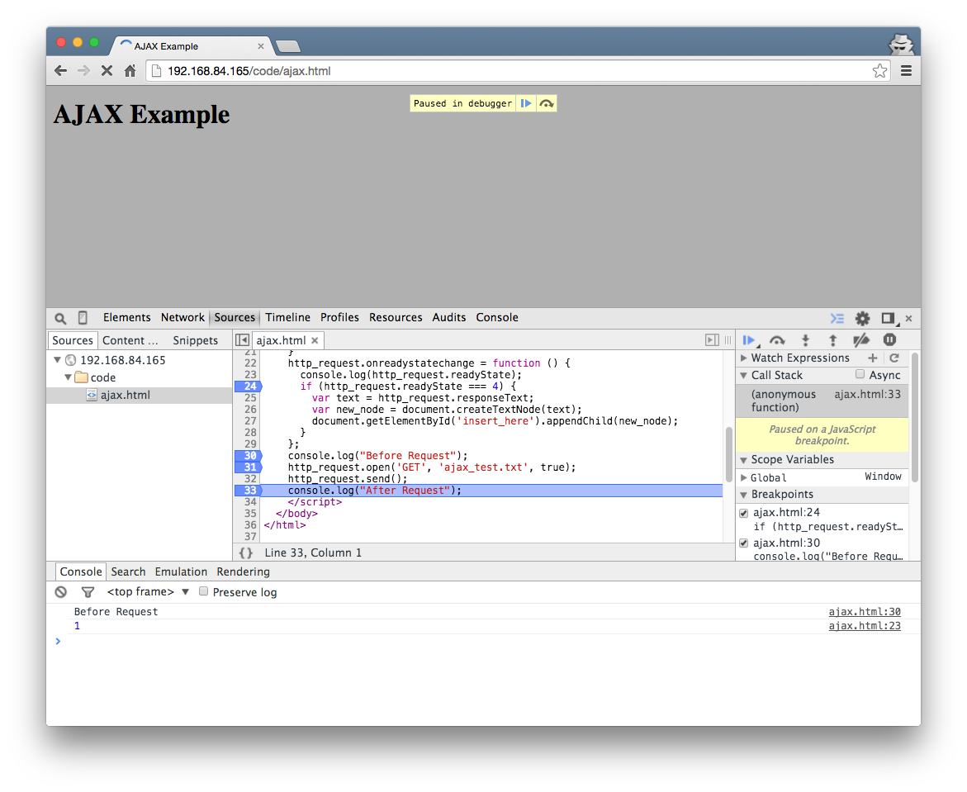

Slide 77
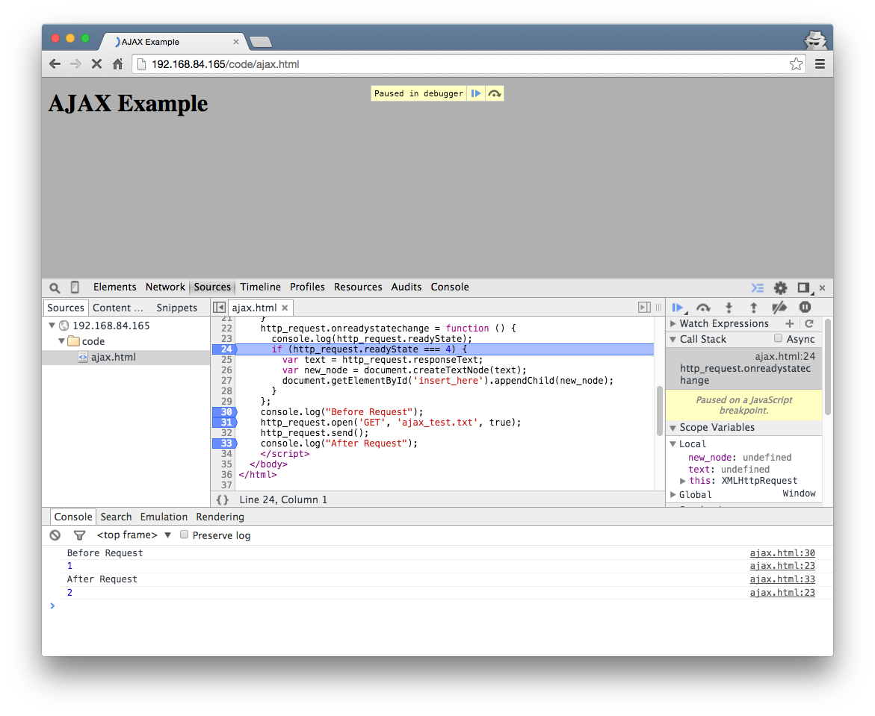

Slide 78
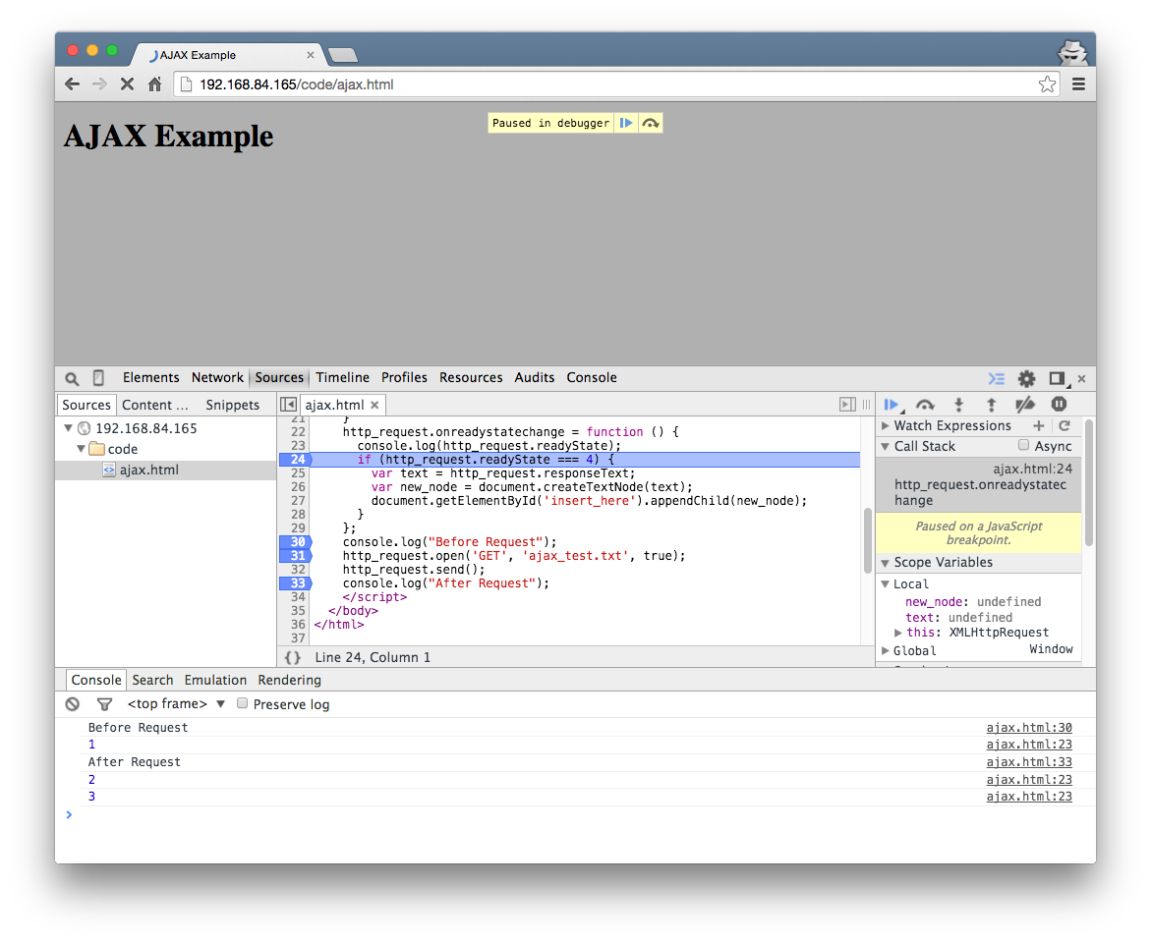

Slide 79


Slide 80
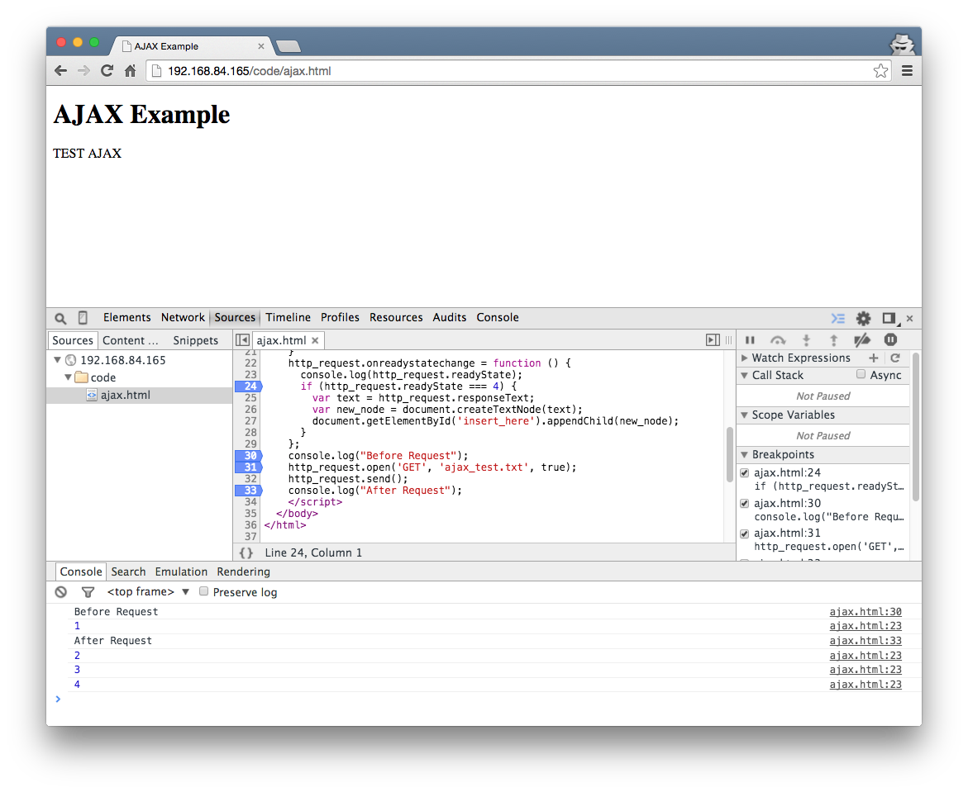

Slide 81
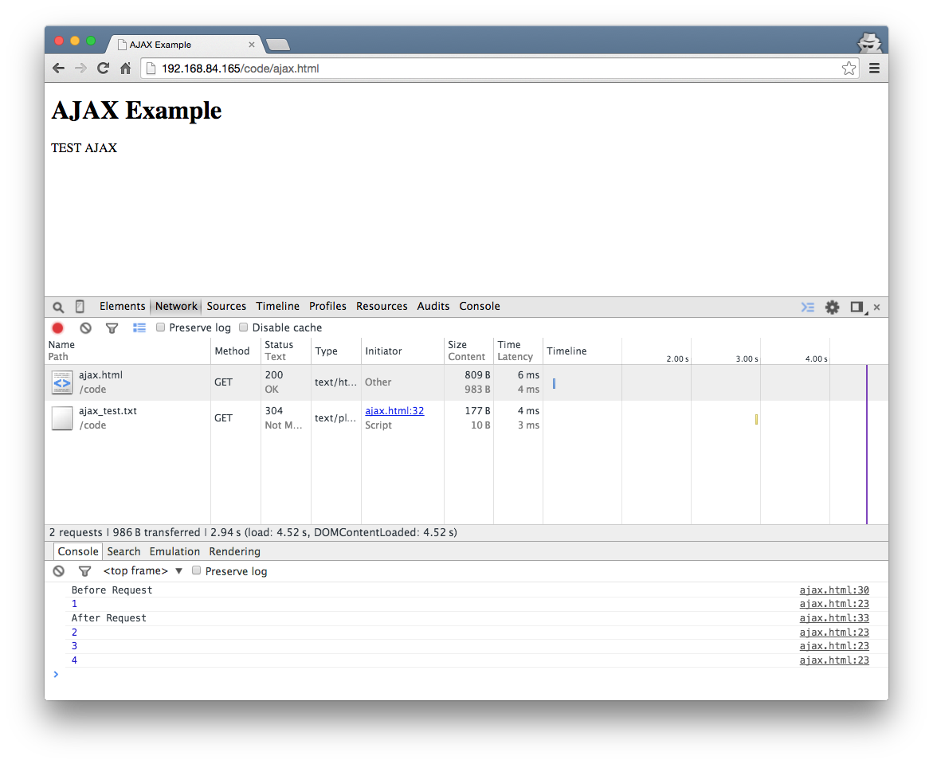

Slide 82
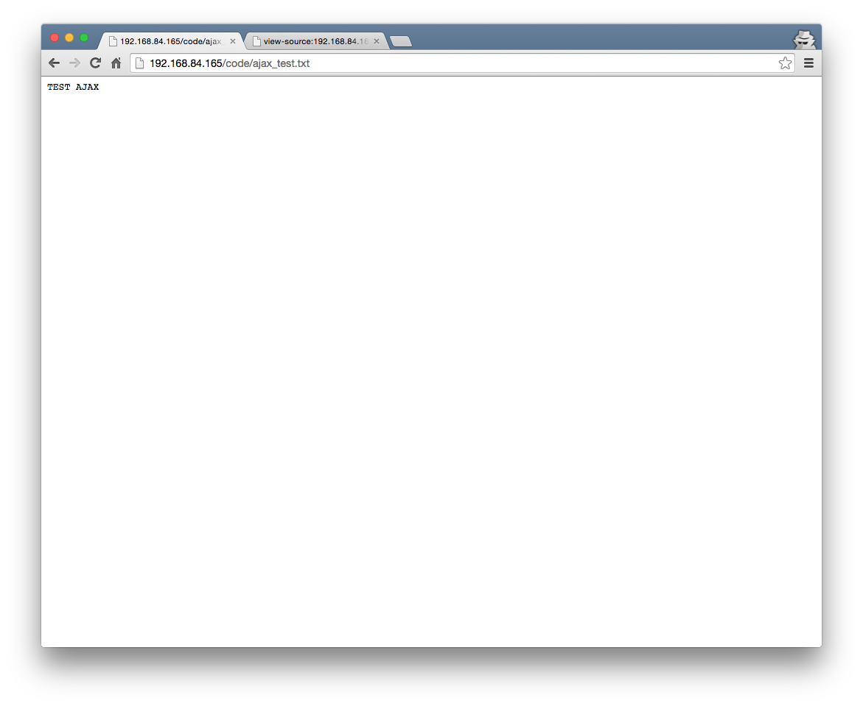

Slide 83
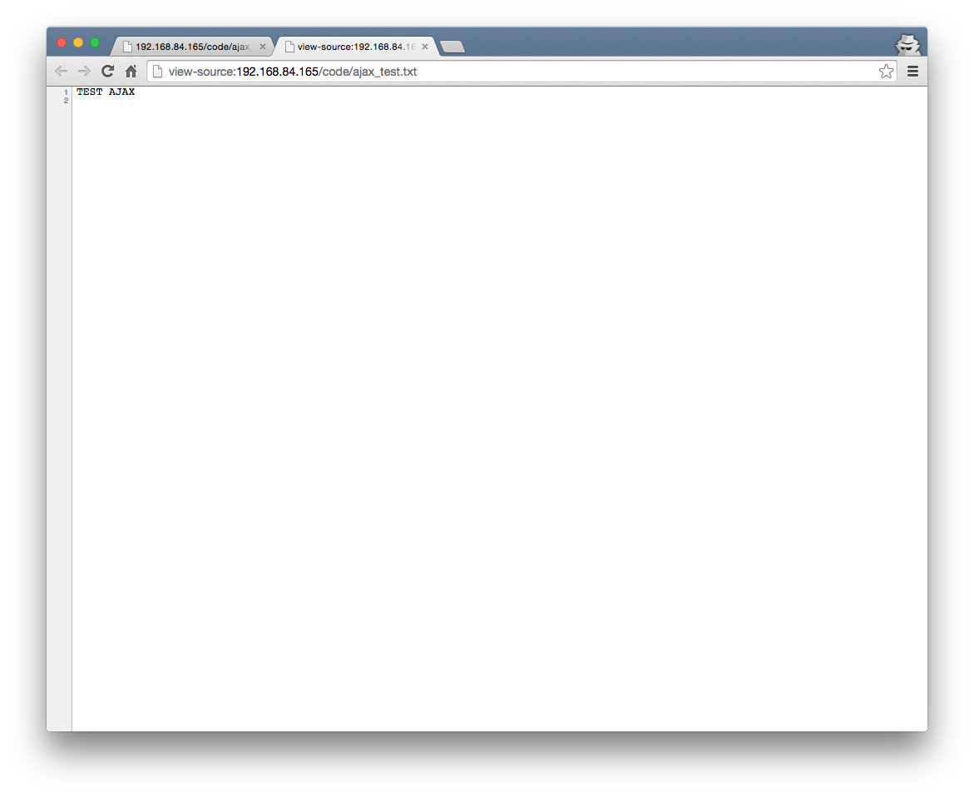

Slide 84
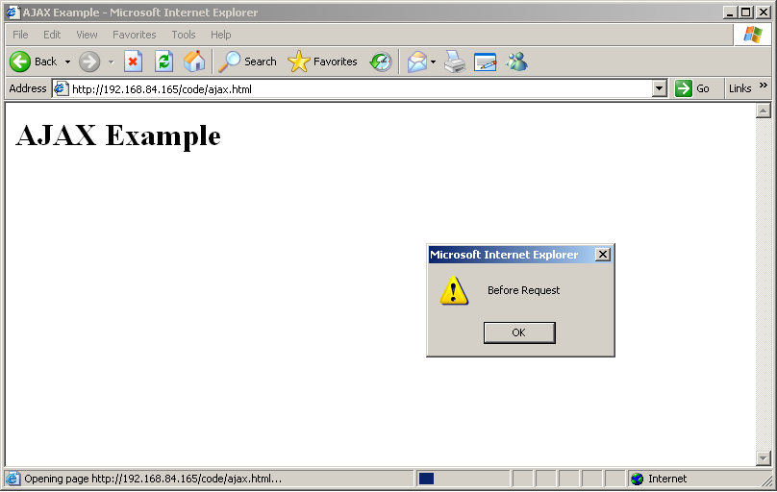

Slide 85
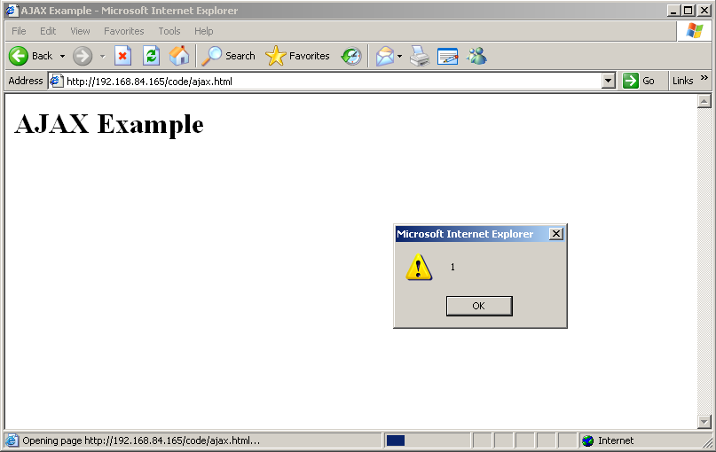

Slide 86
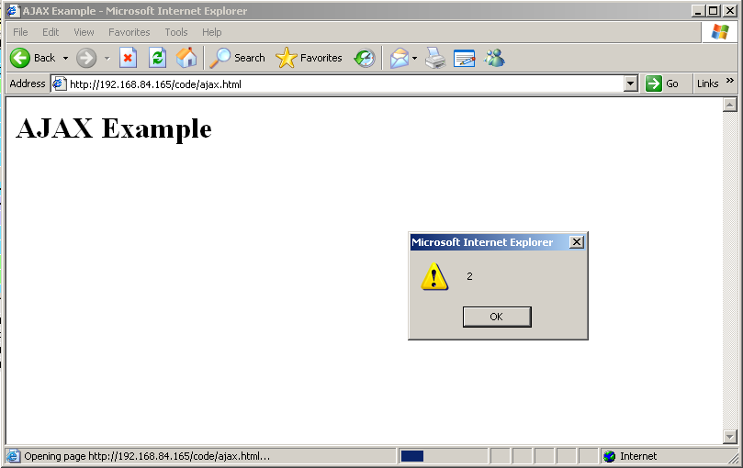

Slide 87
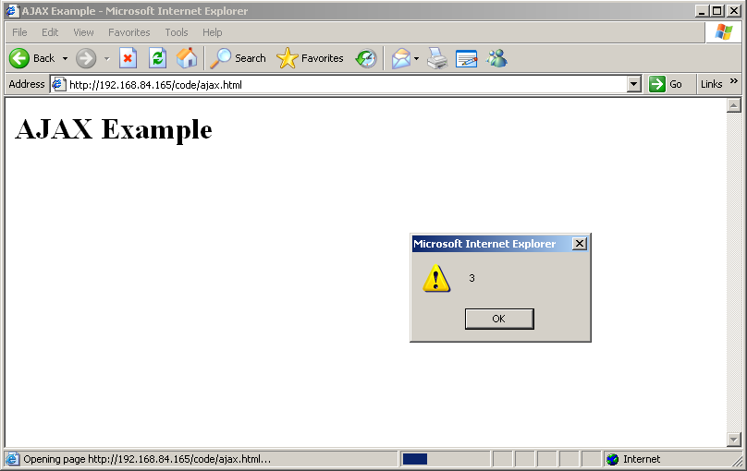

Slide 88


Slide 89
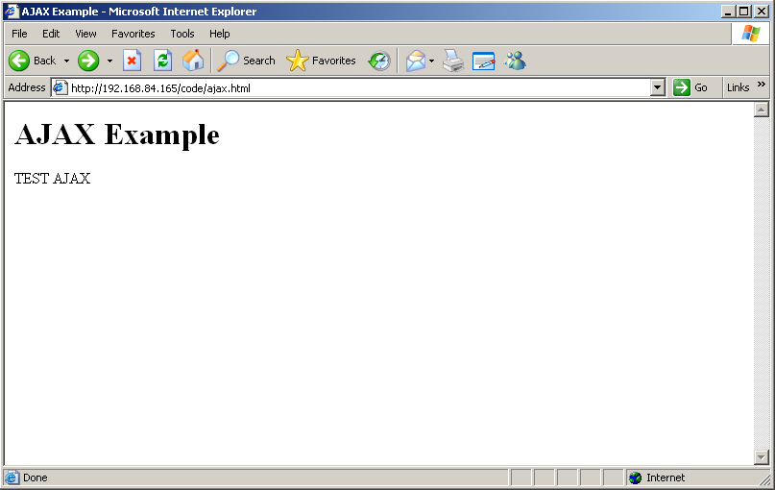

Slide 90
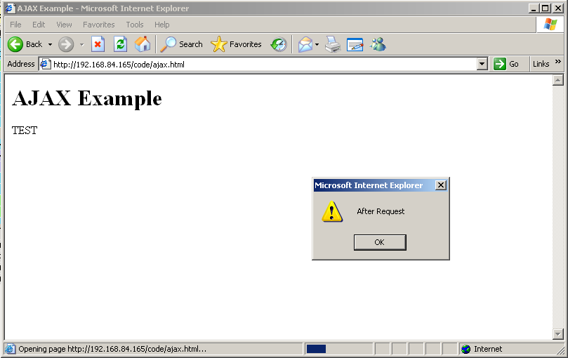

Slide 92
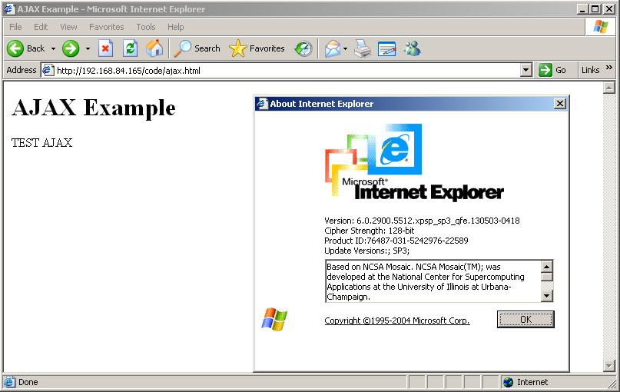

Slide 93
XMLHttpRequest with jQuery
<!DOCTYPE html>
<html>
<head>
<meta charset="UTF-8">
<title>AJAX jQuery Example</title>
</head>
<body>
<h1>AJAX jQuery Example</h1>
<div id='insert_here'>
</div>
<script src="https://ajax.googleapis.com/ajax/libs/jquery/1.11.2/jquery.min.js">
</script>
<script>
$.get( "ajax_test.txt", function( data ) {
$( "#insert_here" ).html( data );
});
</script>
</body>
</html>

Slide 94
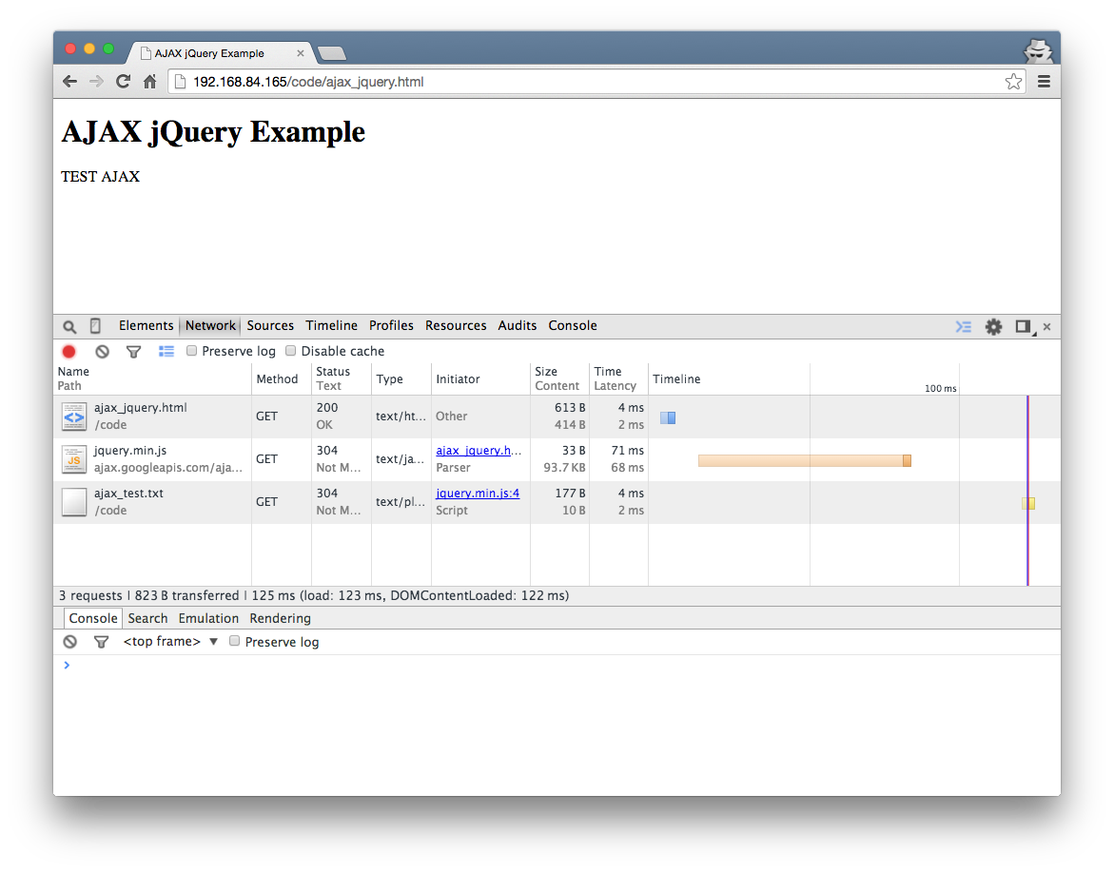

Slide 95
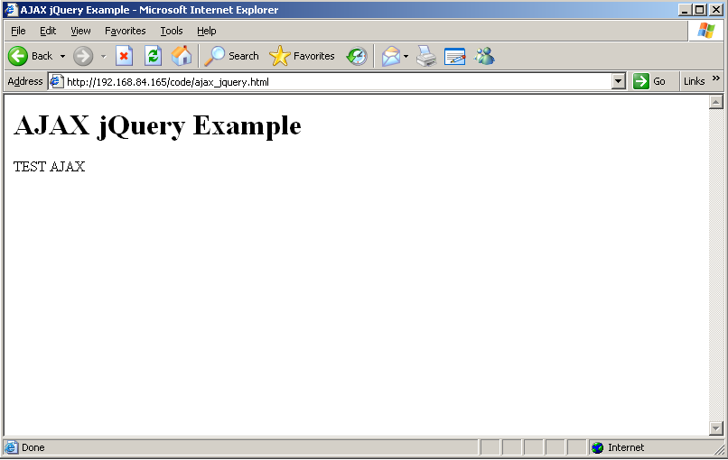

Slide 96
Asynchronous JavaScript and XML – AJAX
Can now make web applications that asynchronously fetch only the required data from the server
  Can also respond to user input (clicks, form), and potentially load data
First reference to the term AJAX
  https://web.archive.org/web/20050223021343/http://adaptivepath.com/publications/essays/archives/000385.php

Slide 97
Client Side Scripting Technologies
Java Applets
ActiveX Controls
Adobe Flash
Silverlight
JavaScript
JavaScript – DOM
JavaScript – XMLHttpRequest

Slide 98
Technologies
URI
Percent Encoding
HTTP Request
HTTP Response
HTTP Authentication
HTML
HTML Character References
Form Urlencoding
Cookies
CGI
ASP
Servlets
JSP
PHP
SQL
Java Applets
ActiveX Controls
Adobe Flash
Silverlight
JavaScript
JavaScript – DOM
JavaScript – XMLHttpRequest

