Slide 1
Clickjacking
CSE 591 – Security and Vulnerability Analysis
Spring 2015
Adam Doupé
Arizona State University
http://adamdoupe.com

Slide 2
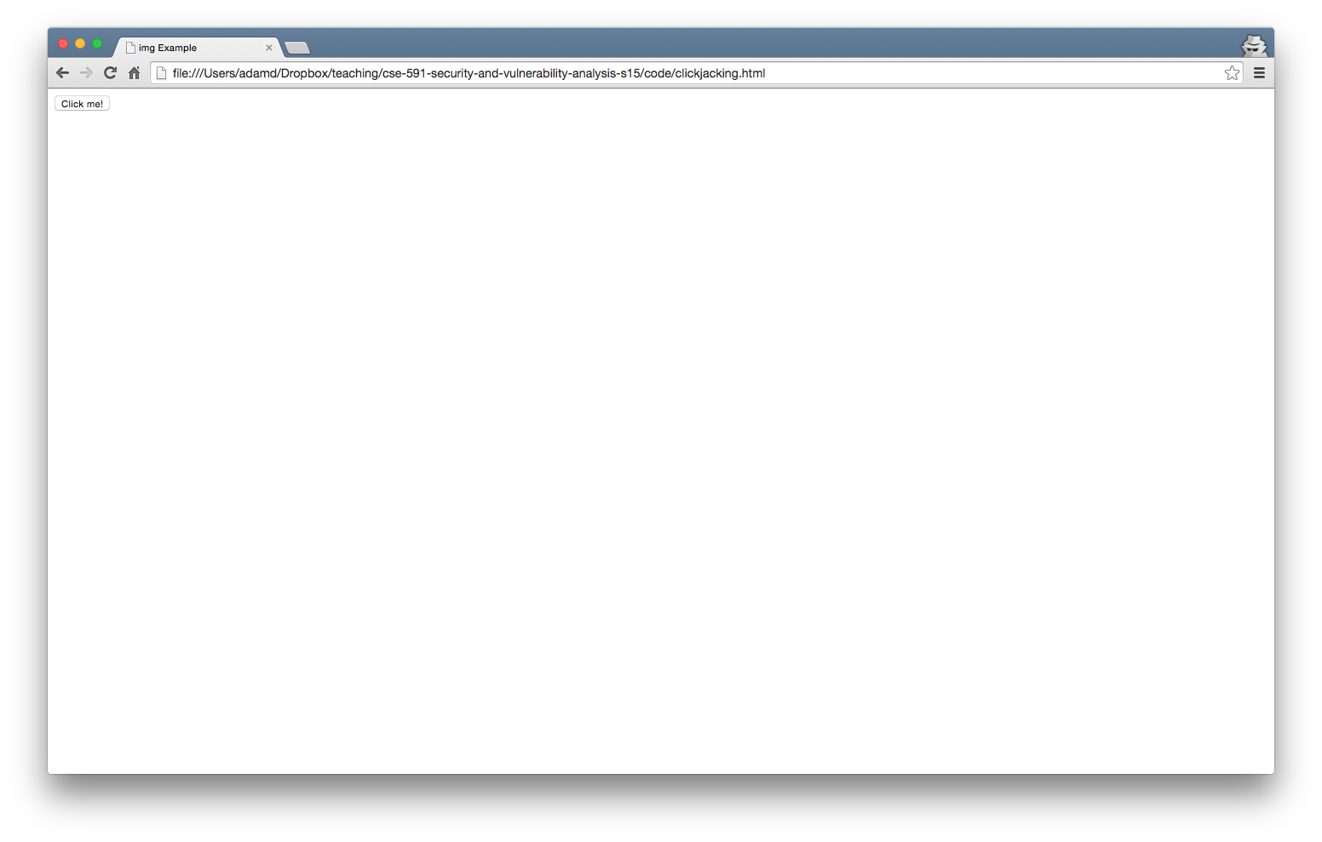
Would you click this button?

Slide 3
ClickJacking
In a clickjacking attack a user is lured into clicking a button that is not associated with the page displayed by the browser
Example: clicking on harmless "Download free screensaver" button a on page on site A will actually become a click on "Like Button" on Facebook
The attack, also called "UI redressing," is performed by using overlapping transparent frames
Stacking order: z-index: <value>
Transparency in Firefox: opacity: <value>
Transparency in IE filter:alpha(opacity=<value>)

Slide 4
ClickJacking Example
<html>
<head>
<title>Clickjacking Times</title>
</head>
<body>
<h1>Clickjacking Example</h1>
<div style="z-index:2; position:absolute; top:0; left:0; width: 100%; height: 100%">
<iframe src="http://www.facebook.com/home.php?" id="frame1" style="opacity:0; filter:alpha(opacity=0);" width="100%" height="100%" />
</iframe>
</div>
<div align="right" style="position:absolute; top:0; left:0; z-index:1; width: 100%; height:100%; background-color: white; text-align:left;">
<p><input type="submit" value="Press Here" /><br />Press this button for an iPhone</p>
</div>
</body>
</html>

Slide 5
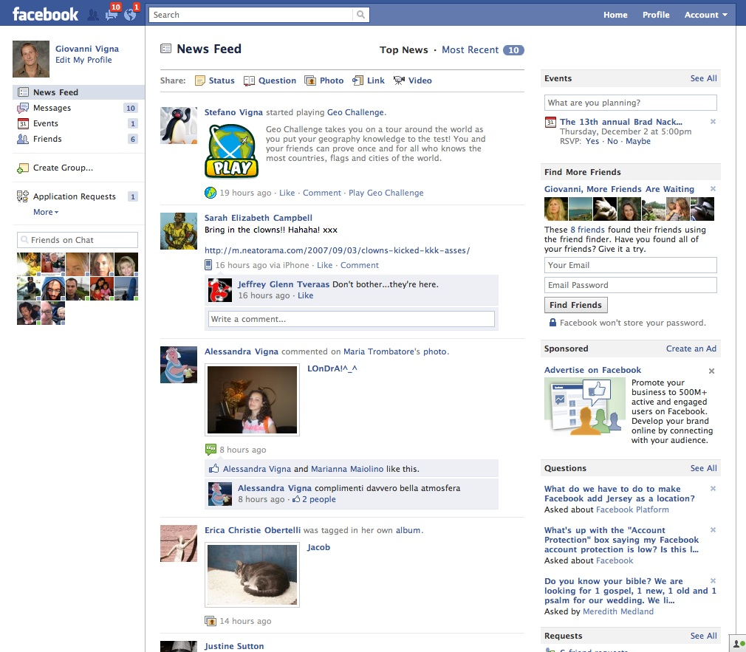
ClickJacking Example
Z-level: 1
Opaque
Press Here!
Z-level: 2
Transparent

Slide 6
Frame Busting Code
<style> body { display:none;} </style>
<script>
if (self == top) {
document.getElementsByTagName("body")[0].style.display = 'block';
}
else {
top.location = self.location;
}
</script>
From: Busting Frame Busting: a Study of Clickjacking Vulnerabilities on Popular Sites, July 2010

Slide 7
HTTP Headers
X-Frame-Options HTTP response header
DENY
This page cannot be framed
SAMEORIGIN
Only pages from the same origin may frame this page
ALLOW-FROM <URI>
Only allow this specific URI to fame this page
https://www.owasp.org/index.php/Clickjacking_Defense_Cheat_Sheet

Slide 8
Summary
Need to be wary of how attacker can trick a user to accidentally take action on your web application
Clickjacking is related to CSRF: both attacks allow an attacker to perform actions on your behalf

